Slide 1

IV CONGRESSO NAZIONALE IVAS
10 - 11 Novembre 2023
VI Sessione:
La vera sfida di questa epoca
è quella di curare
il paziente a casa
Esperienze a confronto
…dalla Puglia con PICC…
A cura di Giovanni Mastrandrea

Slide 2



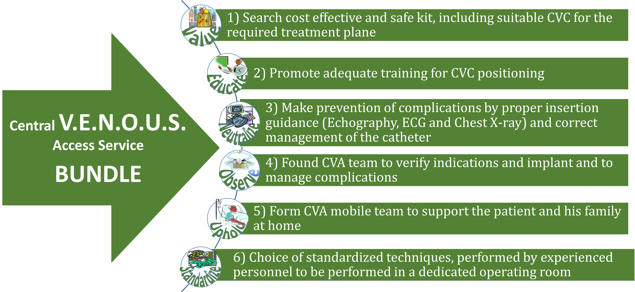
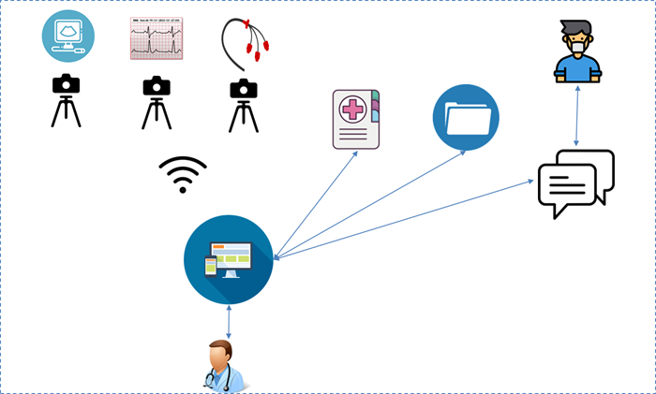
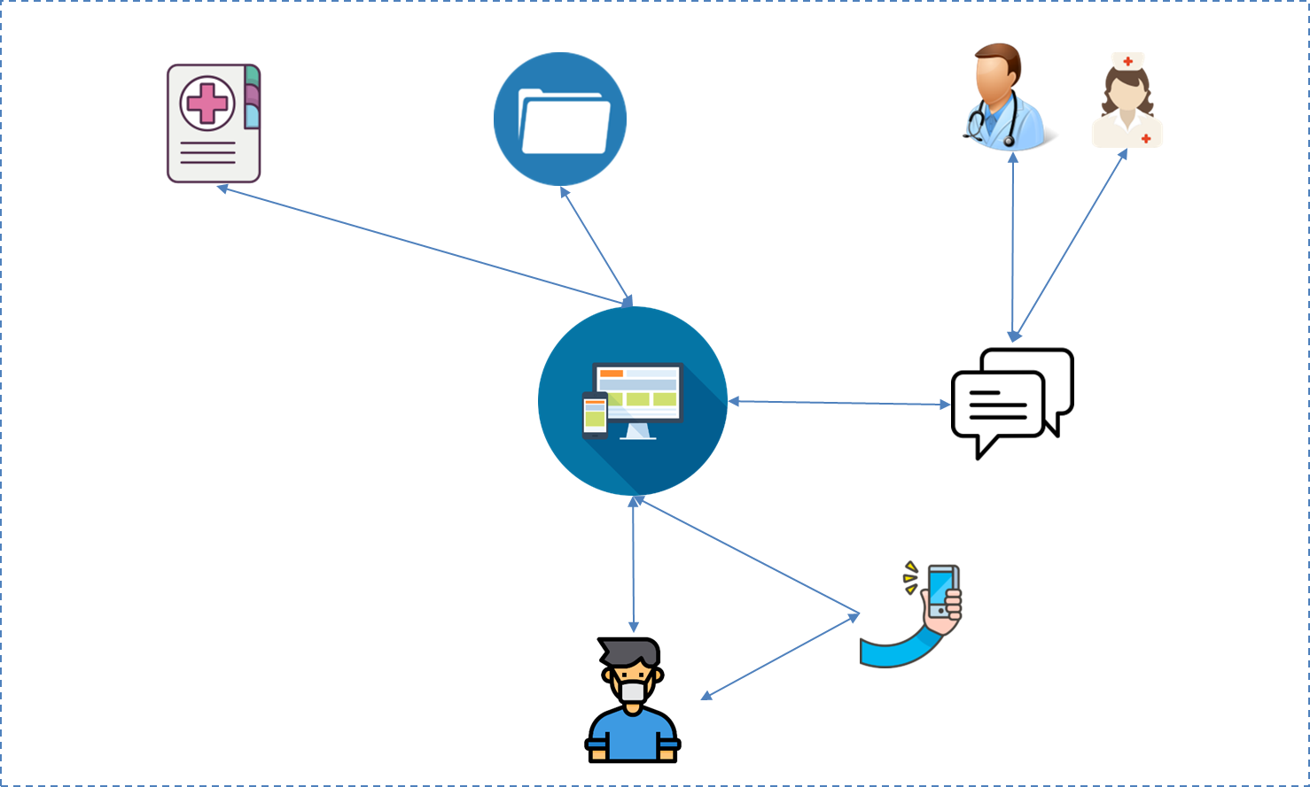
… to Patient Involvement & Images utilization
in Central venous catheter Certification
From traditional hospital-centred organization…
During CVA positioning
During patient’s management
Phase 1:
Mapping and classification of the “Positioning and Management Centers” in Puglia
Phase 2:
Scoping review
Phase 3:
IT platform GDPR compliant
ITp will manage the following intervention scenarios:
In the operating room
In the clinic
At home / in integrated home care

Slide 3


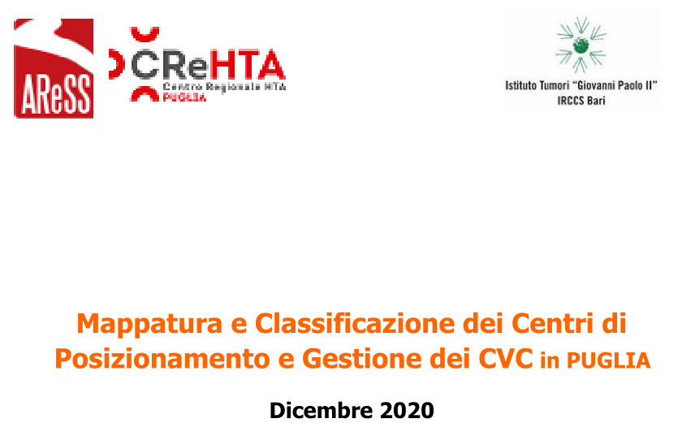
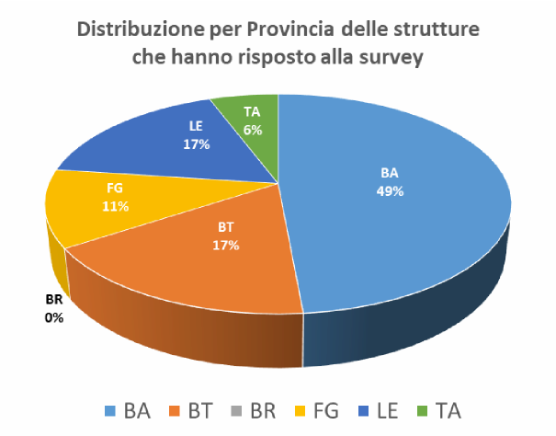
All’indagine hanno aderito 5 Province su 6: BA, BT, FG, LE, TA.
Patient involvement and Images utilization in Central venous catheter Certification
Patient involvement and Images utilization in Central venous catheter Certification
OBIETTIVI
Conoscere numero e distribuzione dei teams accessi venosi regionali
Individuare linee guida (LG), protocolli e buone pratiche adottate dai teams regionali
Verificare l’utilizzo di DM appropriati alle procedure di impianto e gestione dei CVC
L’indagine è stata avviata con richiesta della Direzione Generale AReSS Puglia, per il tramite della Direzioni Generali e Sanitarie delle strutture pubbliche, ai Direttori di U.O.C. di Anestesia e Rianimazione, Chirurgia Generale e Addominale, Chirurgia Vascolare, Radiologia Diagnostica e Interventistica, Oncologia ed Ematologia

Slide 4
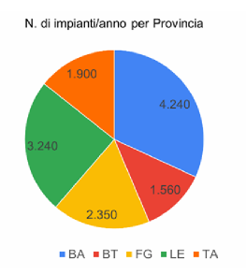
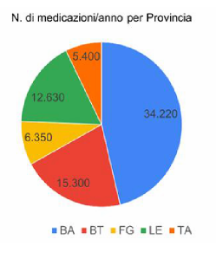
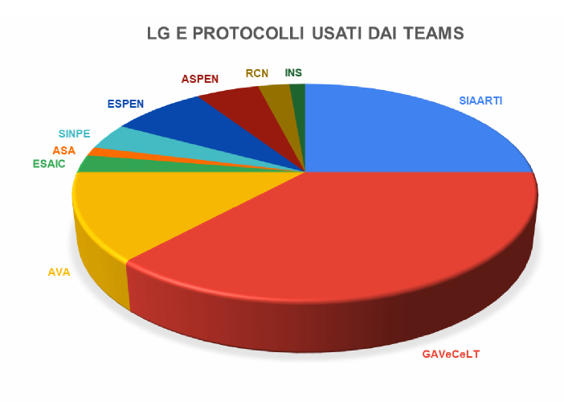
Performances
Patient involvement and Images utilization in Central venous catheter Certification
Patient involvement and Images utilization in Central venous catheter Certification
LG e protocolli

Slide 5
Massime protezioni di barriera
Patient involvement and Images utilization in Central venous catheter Certification
Patient involvement and Images utilization in Central venous catheter Certification
Tip location
15 Centri su 35 (43%)
dichiarano di utilizzare
l’ECG intracavitario per la Tip-Location
in più del 90% degli impianti,
mentre il 48% circa ricorre all’ECG
in più del 70% degli impianti
31 Centri su 35 (89%)
dichiarano di utilizzare
le massime protezioni di barriera
nell'allestimento del campo sterile
nel 100% dei casi
Dressing
l’analisi indica
una maggiore frequenza d’uso
di medicazioni trasparenti semipermeabili,
dispositivi sutureless e
needle free connectors
Eco guida real time
11 Centri su 35 (31%)
dichiarano di utilizzare
tecniche radiologiche intraoperatorie
per la Tip-Location
o per la sua conferma
in più del 70% degli impianti
31 Centri su 35 (89%)
dichiarano di utilizzare
l’eco-guida real time
nel 100% dei casi

Slide 6
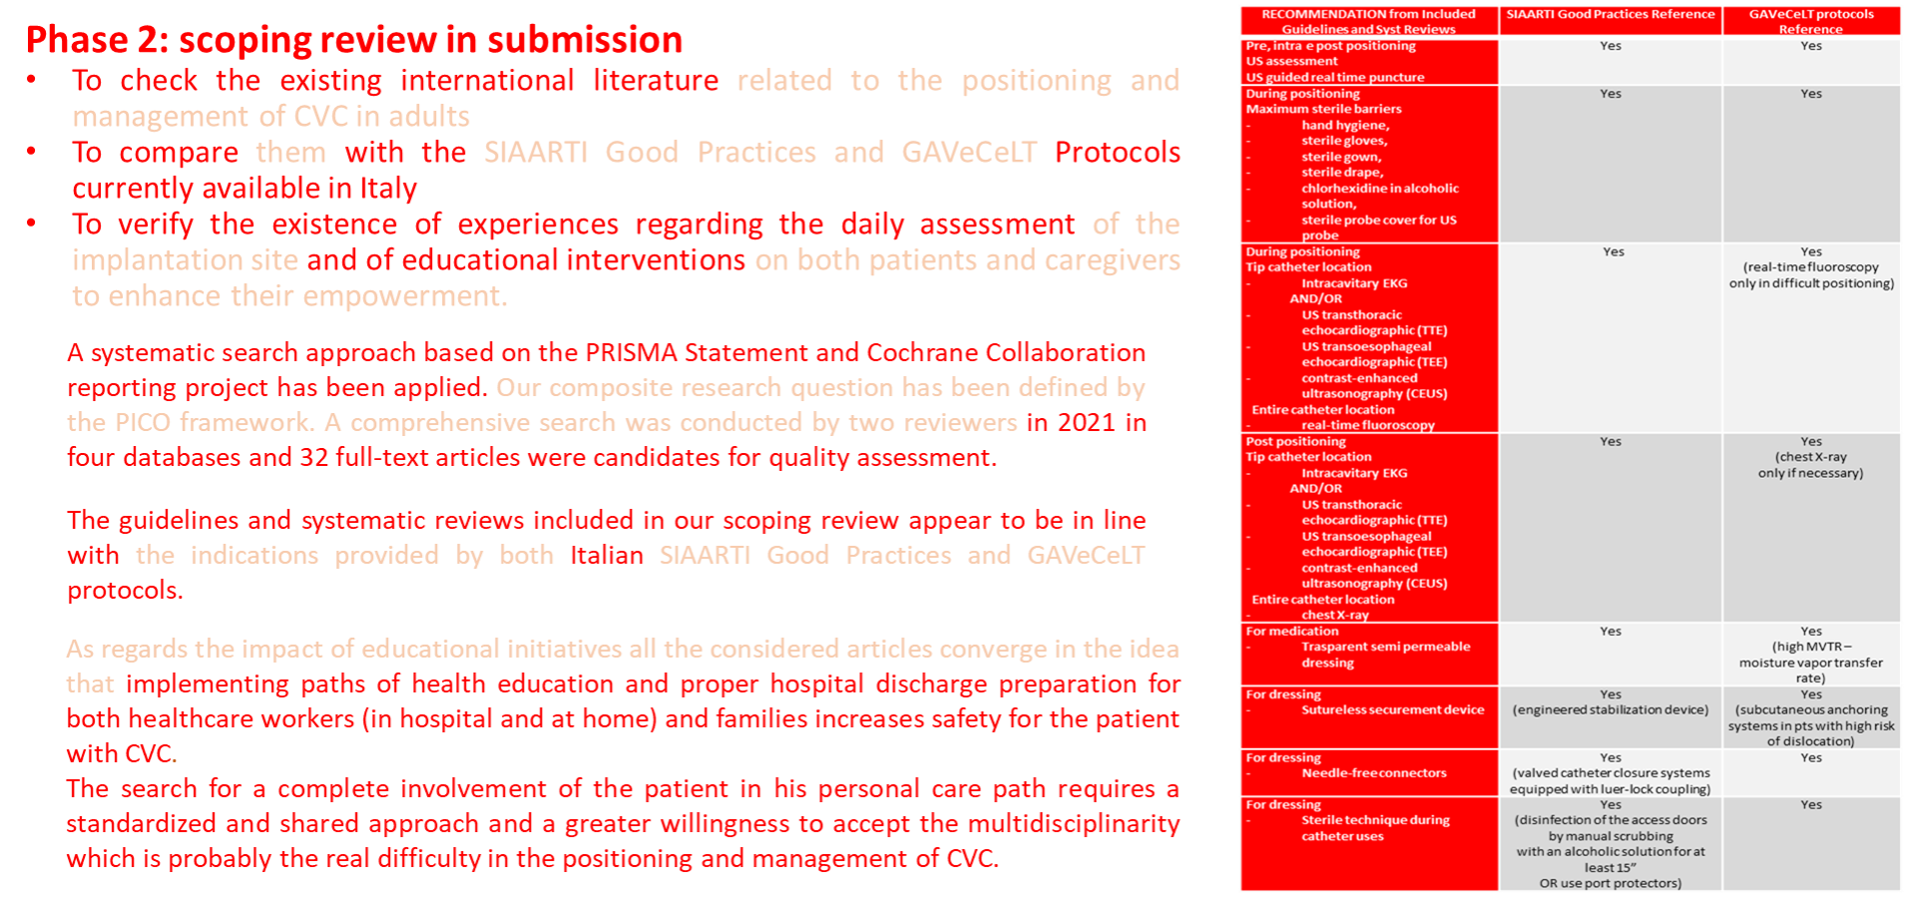
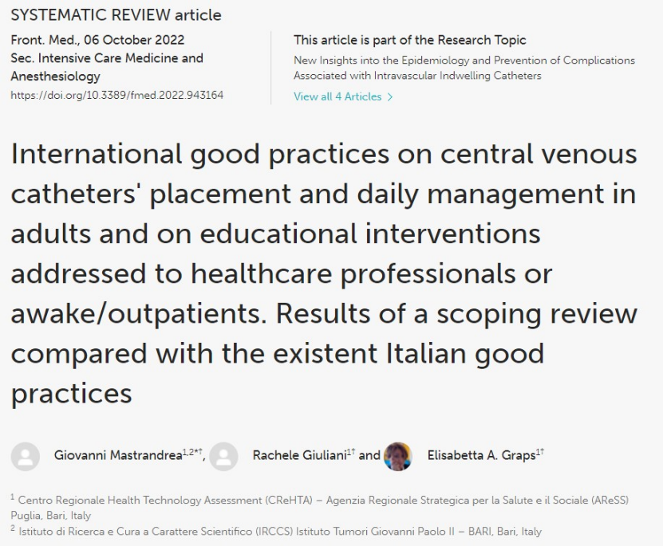
Massime protezioni di barriera
Patient involvement and Images utilization in Central venous catheter Certification
Patient involvement and Images utilization in Central venous catheter Certification
Eco guida
real time
Tip location
Dressing

Slide 7
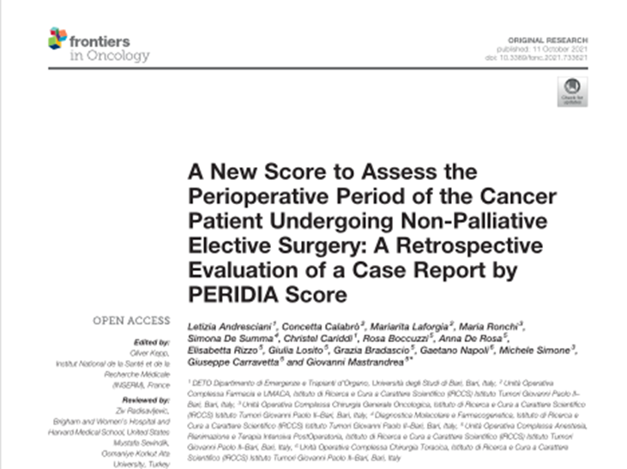
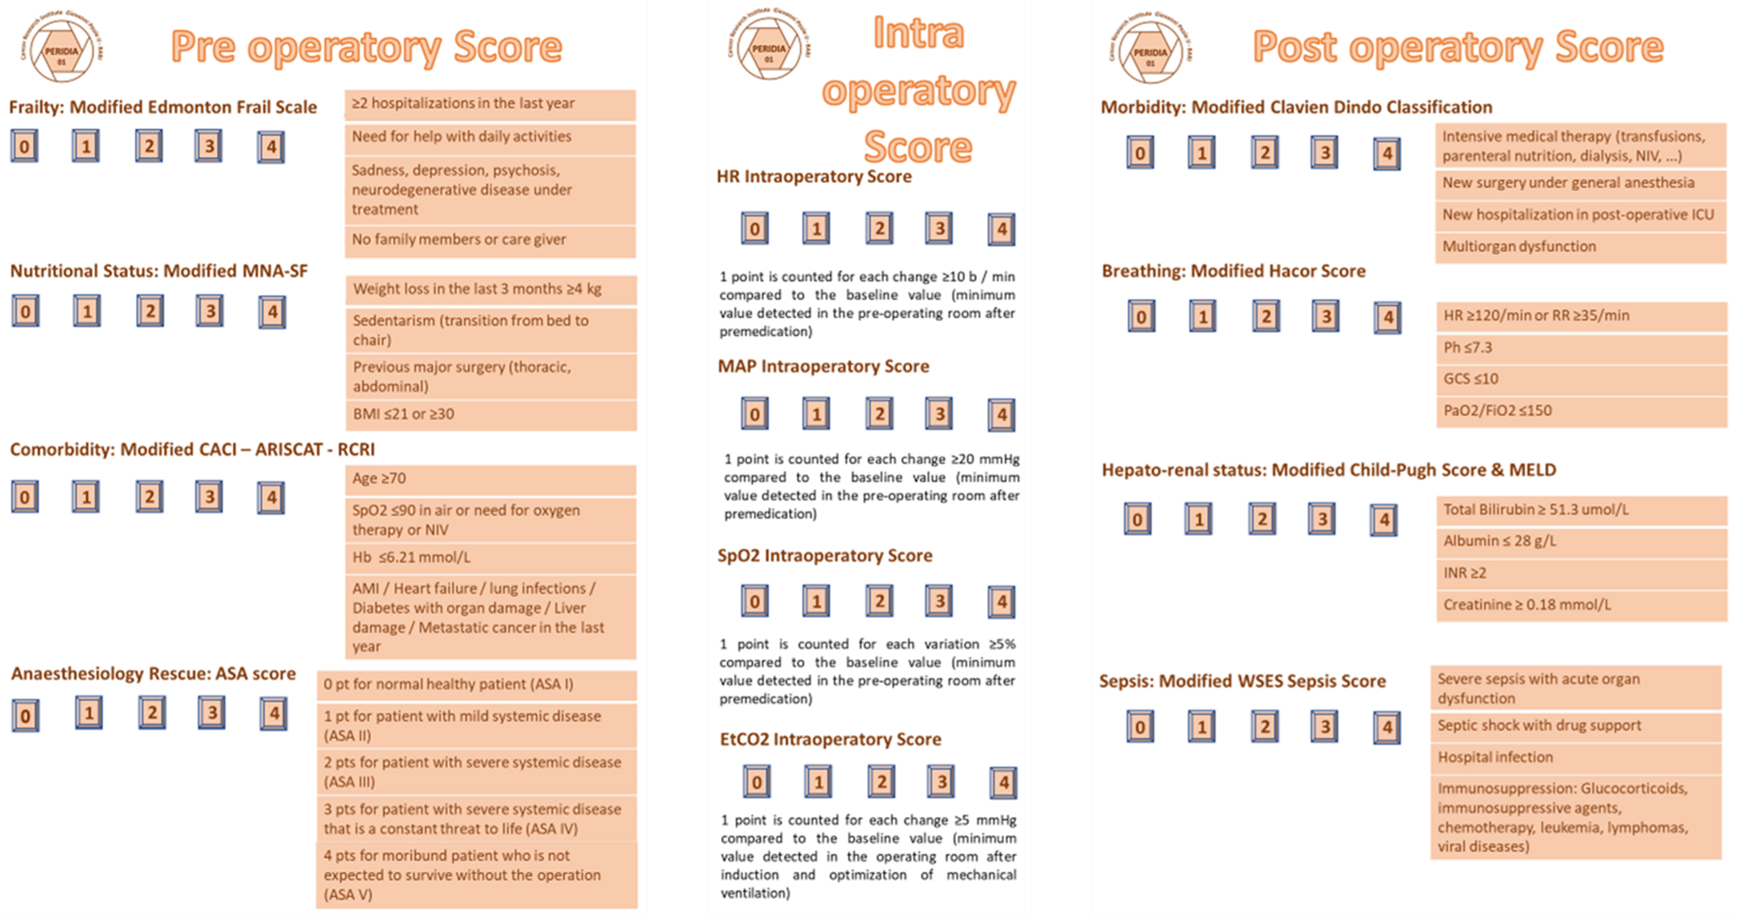
Patient involvement and Images utilization in Central venous catheter Certification
Patient involvement and Images utilization in Central venous catheter Certification
Multidisciplinary approach
Tailored approach
Optimization of patients
Visita preimpianto?
Percorso terapeutico multidisciplinare integrato?
Individuazione di
Paziente
Complesso?
Elaborazione di
score
di valutazione?

Slide 8
Patient involvement and Images utilization in Central venous catheter Certification
Patient involvement and Images utilization in Central venous catheter Certification
… to Patient Involvement & Images utilization
in Central venous catheter Certification
From traditional hospital-centred organization…
During CVA positioning
During patient’s management

Slide 9
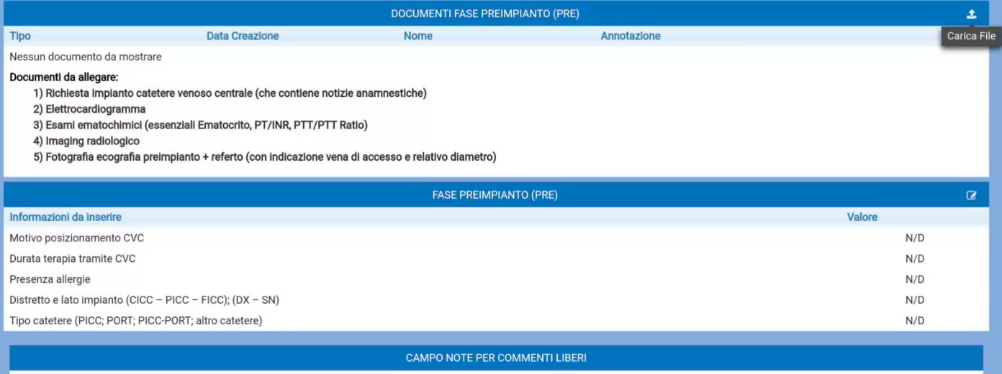

Patient involvement and Images utilization in Central venous catheter Certification
Patient involvement and Images utilization in Central venous catheter Certification

Slide 10
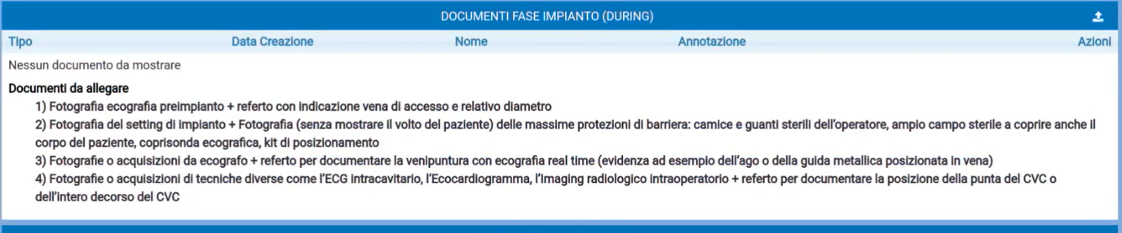
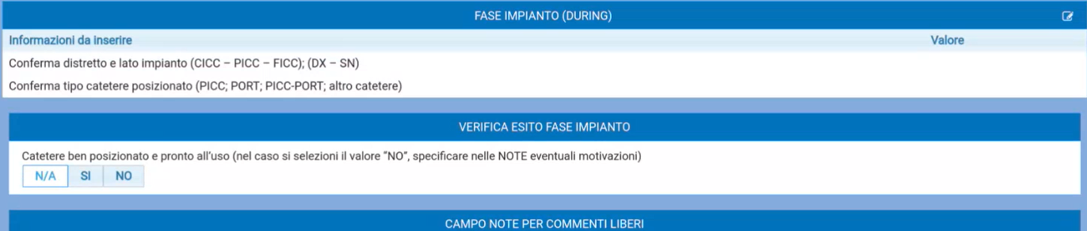
Patient involvement and Images utilization in Central venous catheter Certification
Patient involvement and Images utilization in Central venous catheter Certification

Slide 11
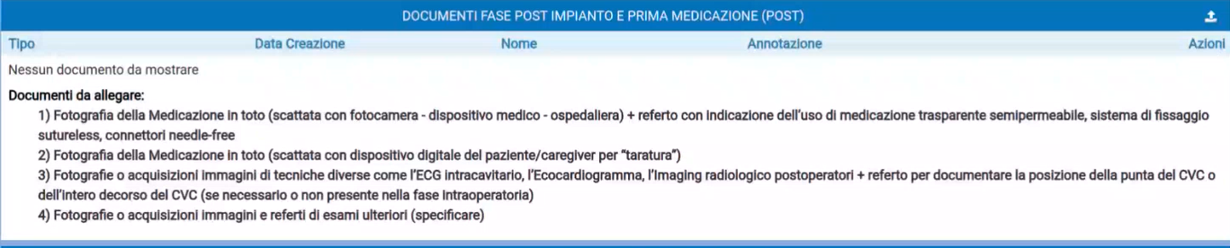
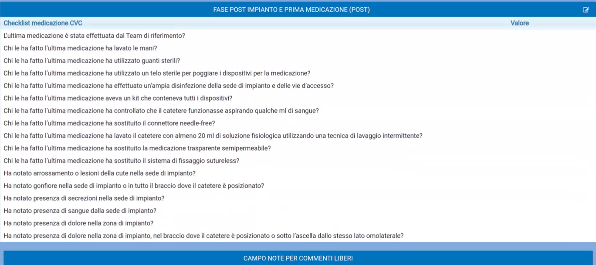
Patient involvement and Images utilization in Central venous catheter Certification
Patient involvement and Images utilization in Central venous catheter Certification

Slide 12
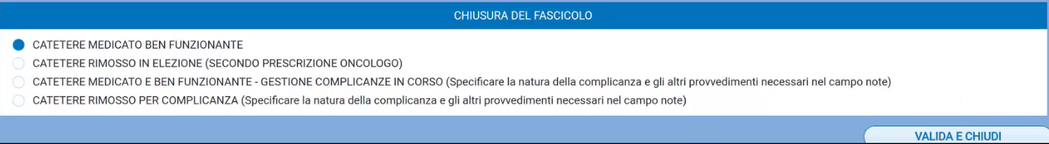

Patient involvement and Images utilization in Central venous catheter Certification
Patient involvement and Images utilization in Central venous catheter Certification
E LA FASE DOMICILIARE?

Slide 13
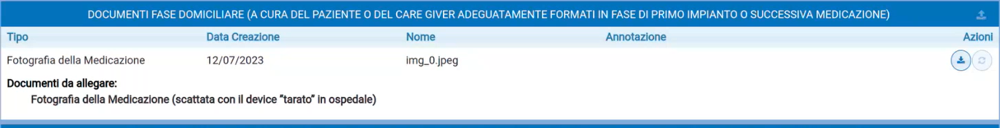
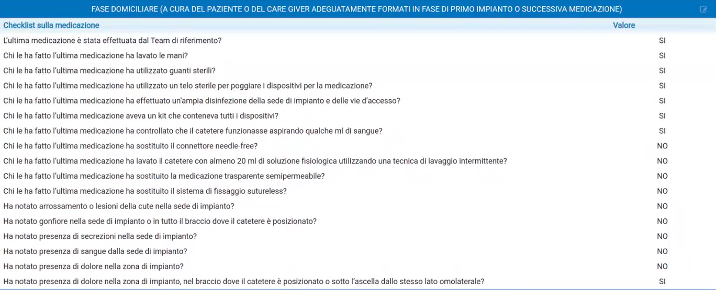
Patient involvement and Images utilization in Central venous catheter Certification
Patient involvement and Images utilization in Central venous catheter Certification

Slide 14
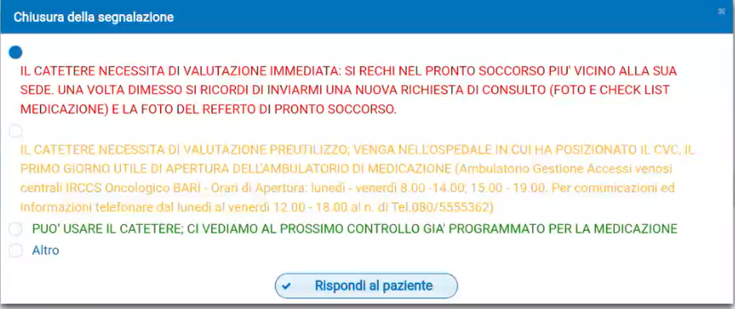
Patient involvement and Images utilization in Central venous catheter Certification
Patient involvement and Images utilization in Central venous catheter Certification

Slide 15
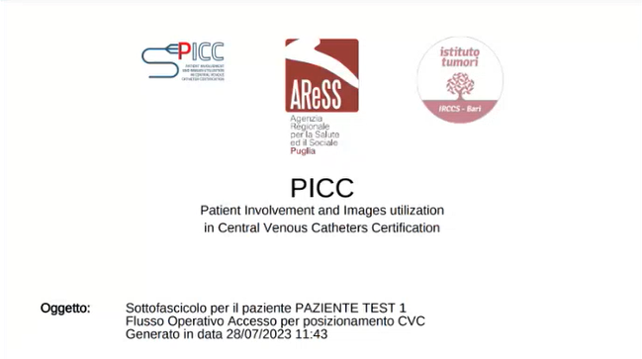
Patient involvement and Images utilization in Central venous catheter Certification
Patient involvement and Images utilization in Central venous catheter Certification

Slide 16
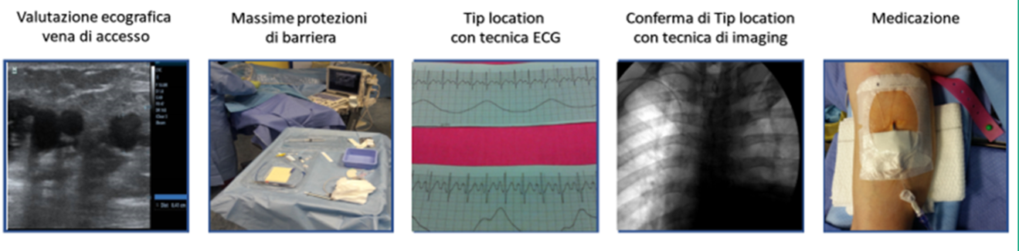
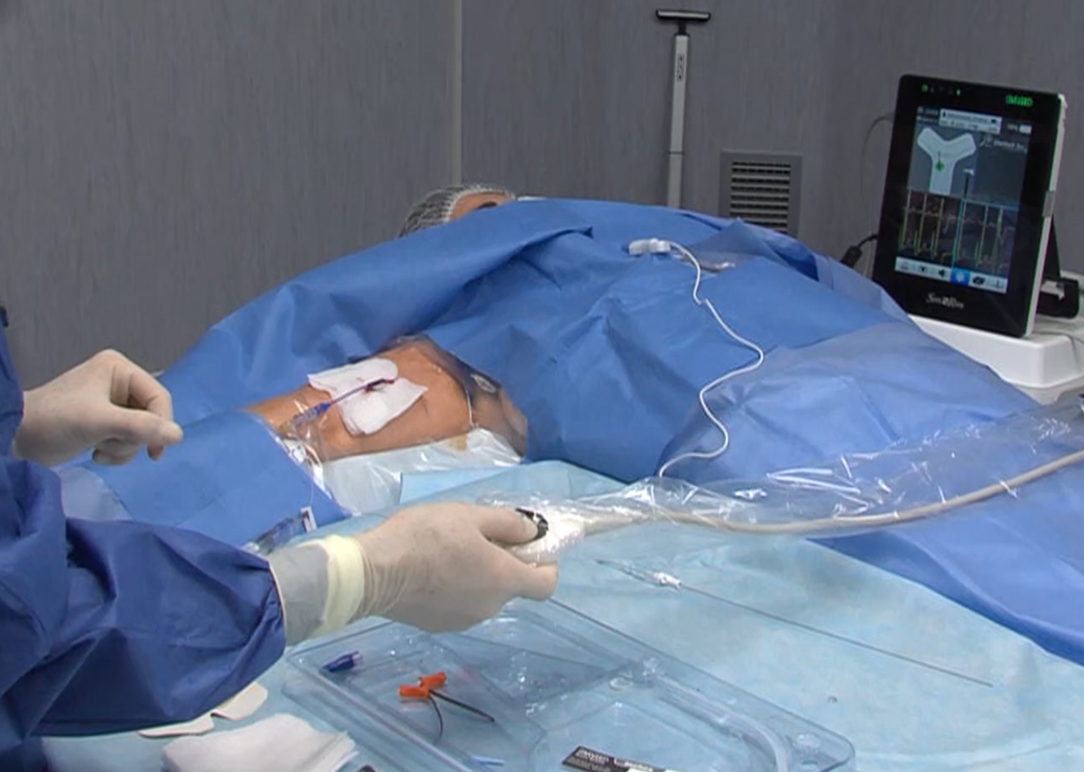
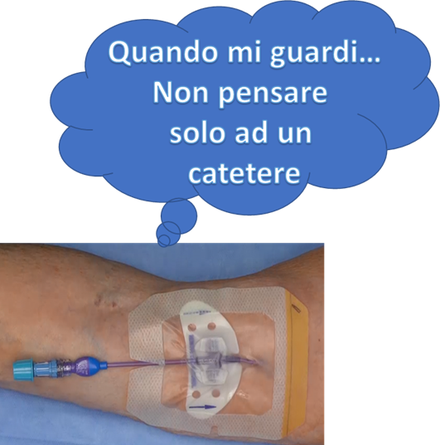
Patient involvement and Images utilization in Central venous catheter Certification
Patient involvement and Images utilization in Central venous catheter Certification
Notes:
Tra il percorso di posizionamento/gestione dei cvc più documentato possibile in hospital and at home…

Slide 17
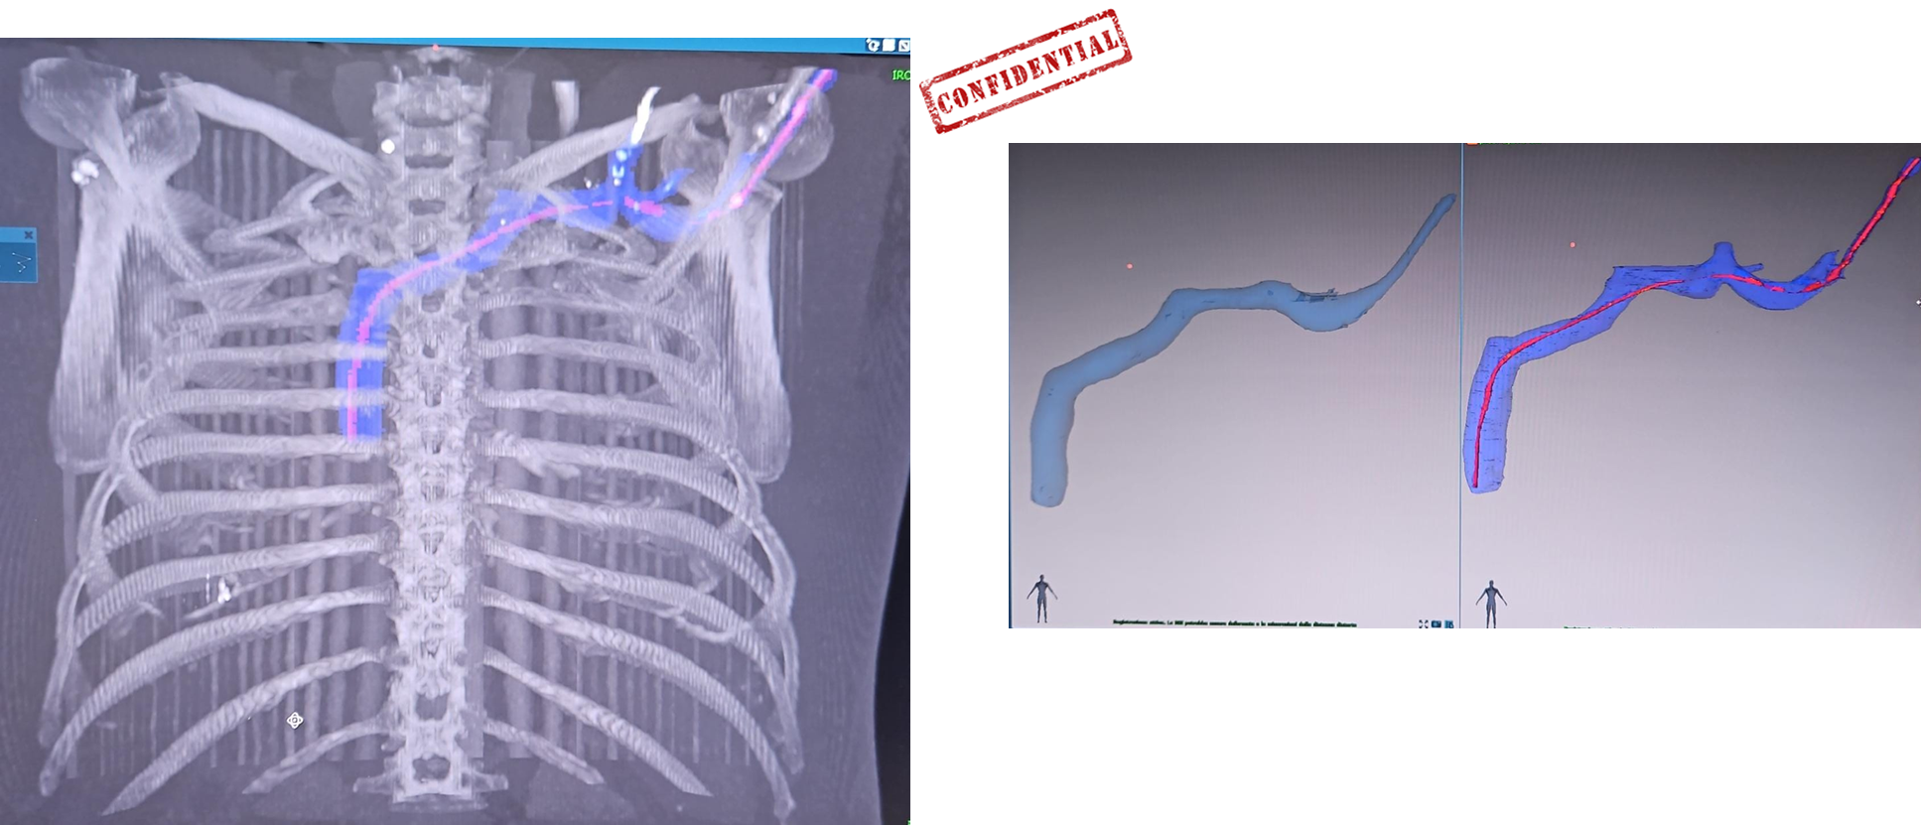
Patient involvement and Images utilization in Central venous catheter Certification
Patient involvement and Images utilization in Central venous catheter Certification
Notes:
E il follow-up dei cvc più documentato possibile

Slide 18
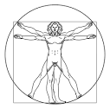
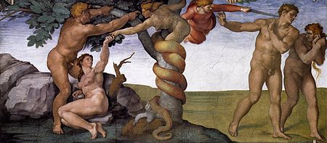

Patient involvement and Images utilization in Central venous catheter Certification
Patient involvement and Images utilization in Central venous catheter Certification
… to Patient Involvement & Images utilization
in Central venous catheter Certification
From traditional hospital-centred organization…
… to Patient Involvement & Images utilization
in Central venous catheter Certification
During CVA positioning
During patient’s management
Notes:
C’è la tecnologia più difficile da governare: la tecnologia uomo/donna che va difesa dalla guerra (con se stessa) e dalla malattia.

Slide 19
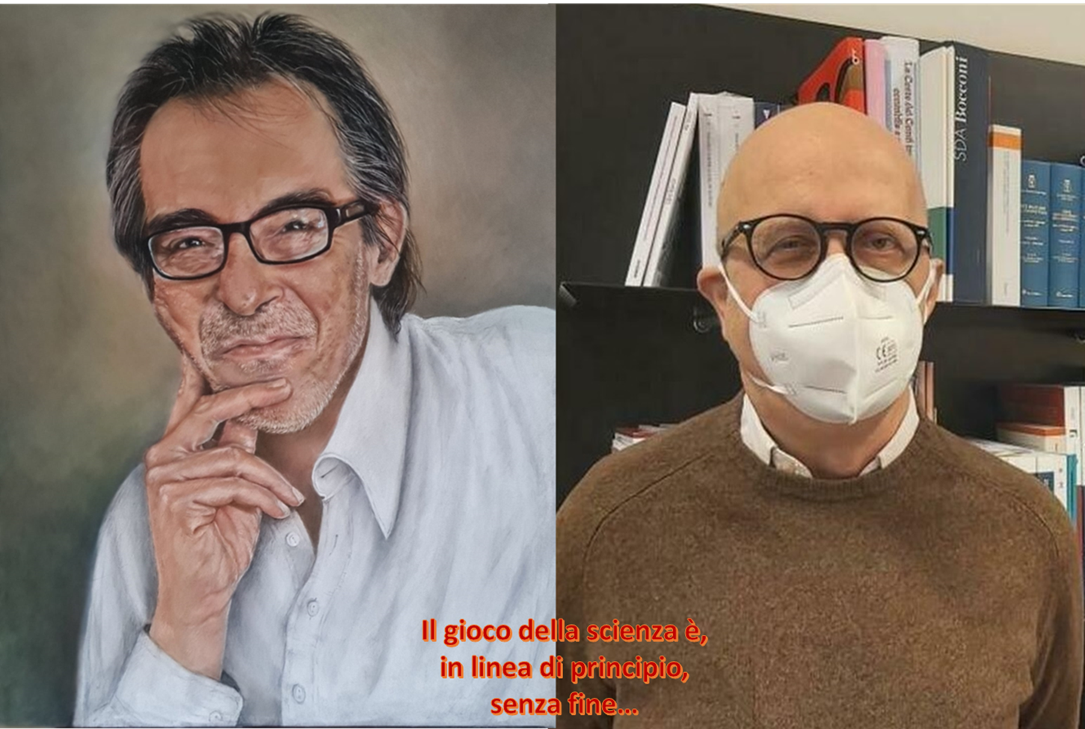
Patient involvement and Images utilization in Central venous catheter Certification
Patient involvement and Images utilization in Central venous catheter Certification
Notes:
Nel ricordo di chi ci ha preceduto e ci ha insegnato il gioco più umano del mondo che è il gioco della scienza

Slide 20
Patient involvement and Images utilization in Central venous catheter Certification
Patient involvement and Images utilization in Central venous catheter Certification

