Slide 1
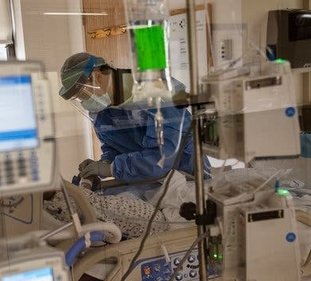
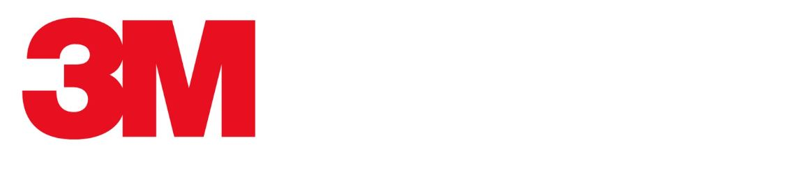
Focus On:
Medicazioni Antimicrobiche
Congresso IVAS
Roma, 11 Novembre 2023
Sara Agnolucci

Slide 2
Disclaimer
Sara Agnolucci, Scientific Affairs & Education Program Manager SEER
Dipendente 3M Healthcare Italy srl

Slide 3
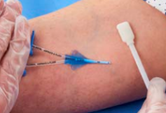
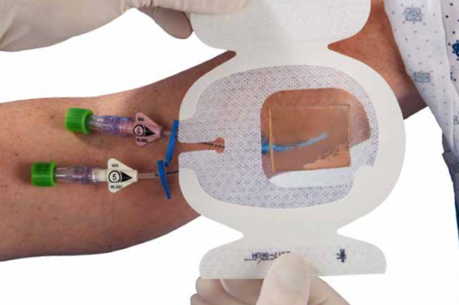
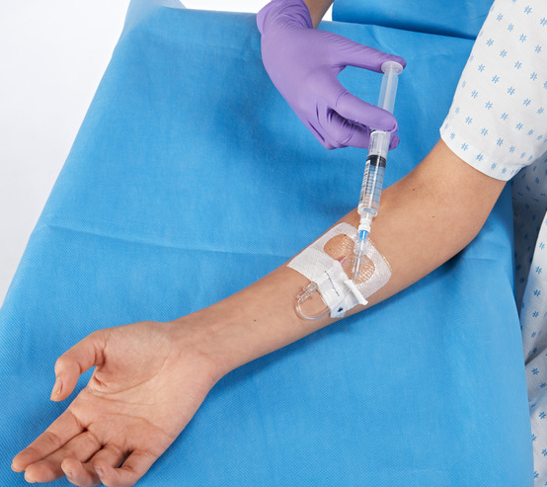
Sfide Cliniche
La Gestione è per la vita del catetere
Inserzione- la procedura è critica ma rappresenta solo un momento per il rischio CRBSI
  Gestione- il rischio di CRBSI si estende a tutti gli aspetti del nursing e del mantenimento durante la permanenza del catetere
Notes:
The first consideration is that maintenance extends throughout the life of the line.
The procedure of inserting a central line is often performed by one clinician, at one time during the life of that line. Therefore, insertion represents only one aspect of the risk for CRBSI.
Maintenance of that line starts immediately after insertion and continues until that line is removed. The line is covered and secured by a dressing in accordance with guidelines and standards. The dressing is monitored and changed every 7 days unless it is found to be loose, soiled or damp. It can be manipulated and accessed by several different people every day, and this happens for the life of that line. Variations in products, practices and techniques between caregivers can increase the risk of infection.

Slide 4
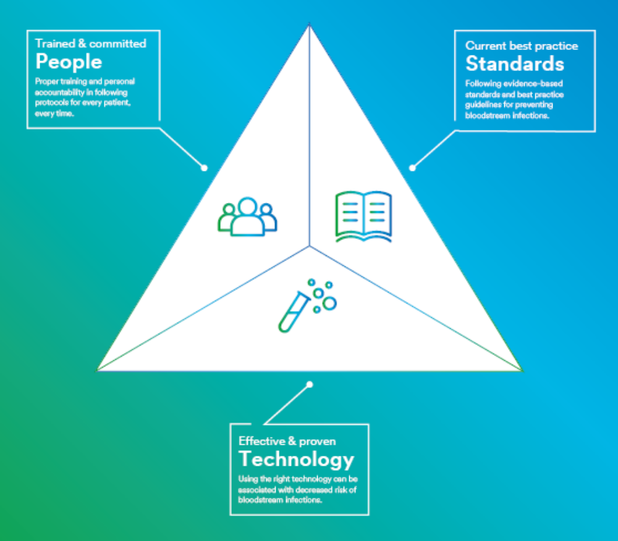
Come ridurre il rischio di infezione
Best practice basate sull'evidenza
Linee Guida, Bundle e Protocolli
Tecnologia basata sull'evidenza/efficace e
comprovata
Personale qualificato
3M può contribuire a ridurre il rischio
di infezione, in modo che tu possa concentrarti solo sul paziente.
Notes:
Eliminating BSIs cannot be achieved with a single initiative, process or technology. All avenues of infection protection must be explored and implemented.

Slide 5
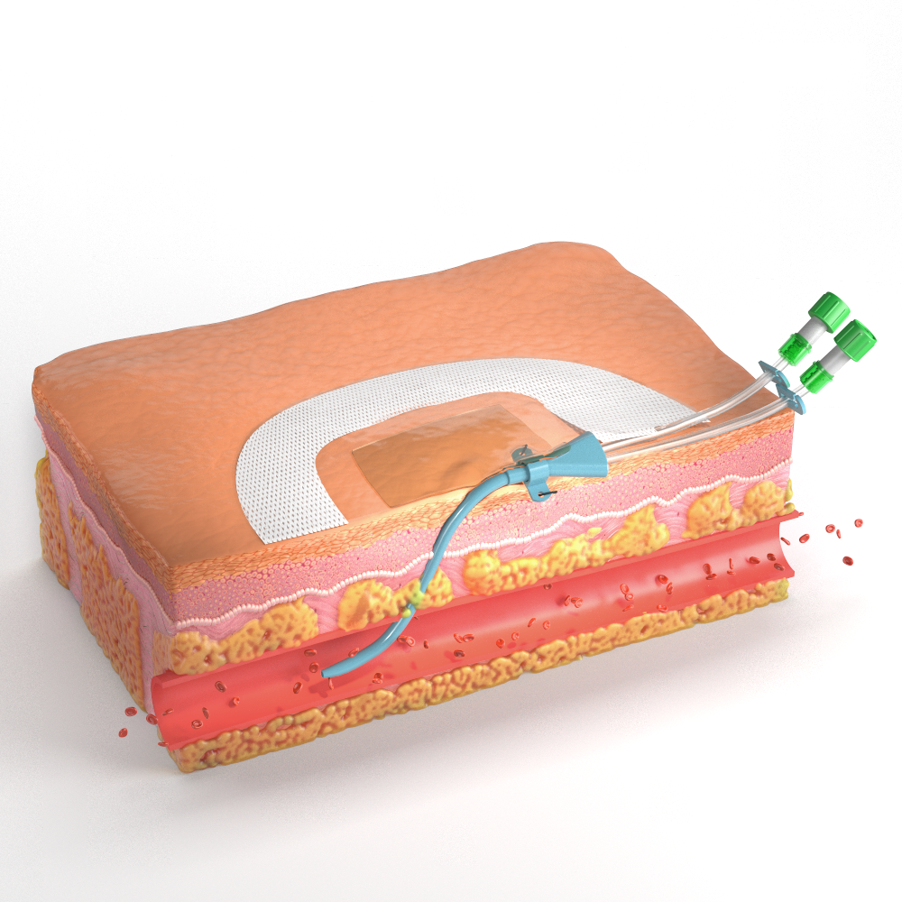
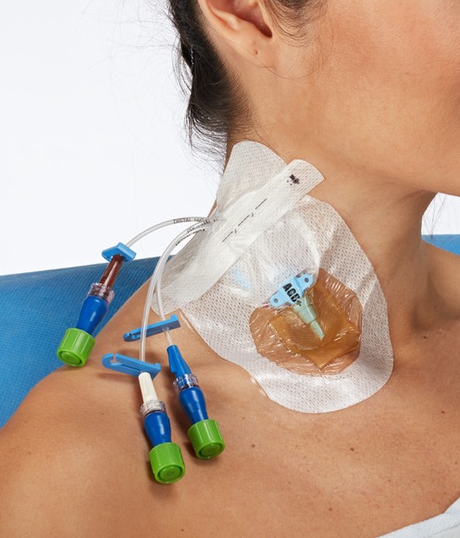
Tecnologia
Notes:
3M Tegaderm™ CHG IV Securement Dressing
3M Curos™ Disinfecting Port Protectors

Slide 6

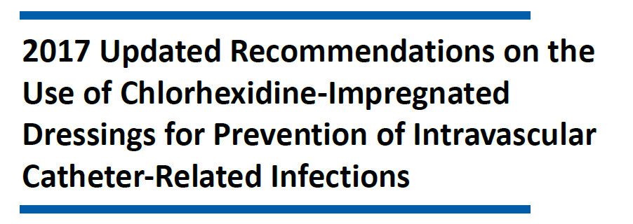
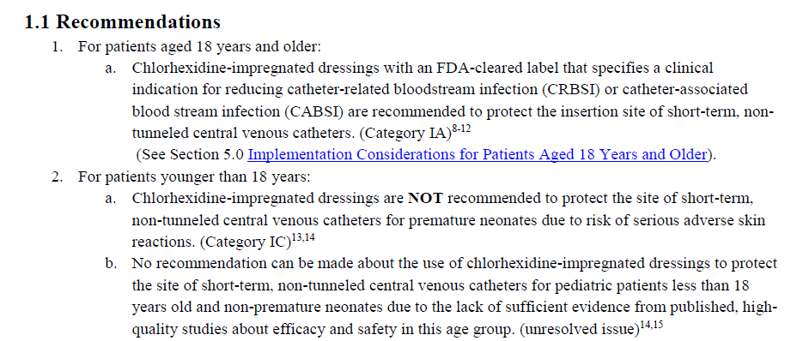
CDC Atlanta
Update 2017
Notes:
Negli anni successivi, la pubblicazione di nuovi studi ha fatto si che i CDC pubblicassero un aggiornamento, vengono incluse le medicazioni trasparenti con CHG (categoria 1°)

Slide 7
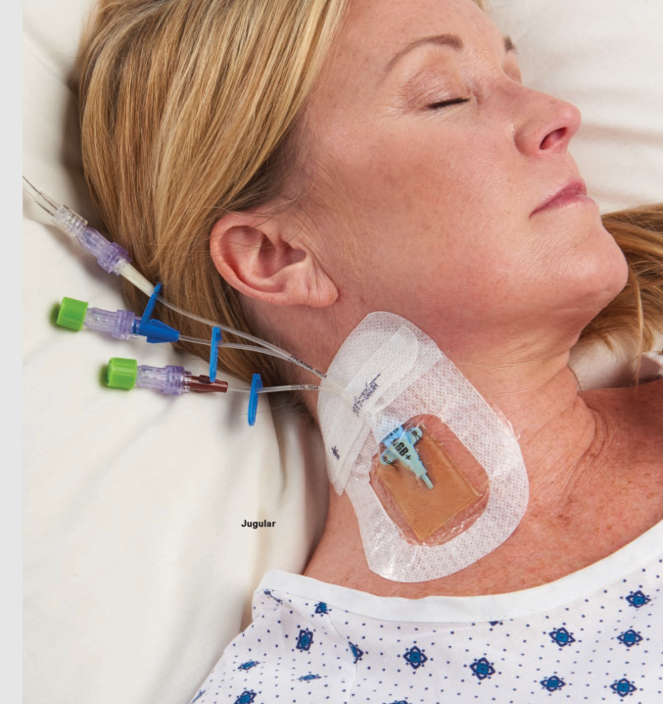
Soluzioni clinicamente testate per la protezione extraluminale
3M™ Tegaderm™ CHG I.V.
Riduzione delle infezioni
Tegaderm CHG è clinicamente testato per ridurre le CRBSIs
del 60% in pazienti con linee centrali e arteriose¹¹
Soddisfa gli standard e le linee guida, comprese le linee guida CDC, INS; Raccomandazione per l'uso di medicazioni impregnate di clorexidina con chiara indicazione per la riduzione della CRBSI
Corretta Applicazione
Visibilità del Sito
Fissaggio del Catetere
La medicazione integrata con gel Pad CHG permette un’applicazione standardizzata
La medicazione e il Gel trasparente permettono l’identificazione di complicanze
Progettato per minimizzare i movimenti del catetere e dislocazioni
Tegaderm CHG I.V. Medicazione per fissaggio è l'unica medicazione trasparente autorizzata e testata per ridurre la CRBSI.
Notes:
1. Tegaderm™ CHG is clinically proven to reduce CRBSIs by 60% in patients with central and arterial lines¹
2. Righetti M, Palmieri N, Bracchi O, et al. Tegaderm™ CHG Dressing significantly improves catheter-related infection rate in hemodialysis patients. J Vasc Access. 2016;17(5):417-422.
3. Thokala P, Arrowsmith M, Poku E, Martyn-St. James M, Anderson J, Foster S, Elliott T, Whitehouse T. Economic impact of Tegaderm chlorhexidine gluconate (CHG)
dressing in critically ill patients. J Infect Prev. 2016;17(5):216-223.
4. Tacconelli E, Smith G, Hieke K, Lafuma A, Bastide P. Epidemiology, medical outcomes and costs of catheter-related bloodstream infections in intensive care units of four European countries: literature- and registry-based estimates. J Hosp Infect. 2009 Jun;72(2):97-103. doi: 10.1016/j.jhin.2008.12.012. Epub 2009 Feb 25.

Slide 8
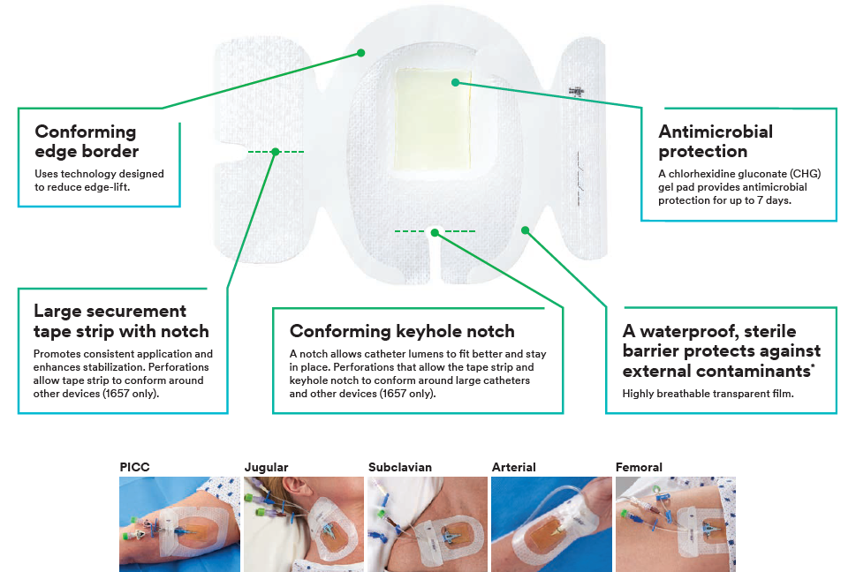
3M™ Tegaderm™ CHG I.V. Medicazioni per fissaggio
Notes:
Capacità di fissaggio
Trasparente per exit site
Assorbimento perchè è un idrogel
E ha un’elevata traspirabilità documentata in scheda tecnica

Slide 9









https://multimedia.3m.com/mws/media/1791529O/3mrm-chg-dressing-clinical-evidence-summary.pdf
The evidence is clear.
View full clinical evidence summary
Robusto corpo di evidenze
3M™ Tegaderm™ CHG Chlorhexidine Gluconate I.V. Securement Dressing.
22 Studi
Più di
30,000
Oltre il 45%
to date including meta-analysis,
Randomized controlled trials,
peer-reviewed studies and posters
Pubblicati negli ultimi cinque anni (2015–2020)
Pazienti studiati
Tipologie di catetere studiate
Argomenti analizzati
CVC (long-term & short-term)
Arterioso
Drenaggio ventricolare esterno
Dialisi
Epidurale
Infection Reduction
Antimicrobial Protection
Ease of Use
Health Economics
Product usability and clinician preference.
Measurable decrease in catheter-related bloodstream infection (CRBSI) rate.
Microbial colonization and in vitro zone
of inhibition.*
Cost savings and overall economic impact.
*No clinical correlation intended.
© 3M 2020. All Rights Reserved. 3M Confidential.
Notes:
Here is a summary slide detailing eh evidence for 3M™ Tegaderm™ CHG Chlorhexidine Gluconate I.V. Securement Dressings by leading researchers in infection prevention and infusion therapy. With 22 clinical studies to date that include more than 30,000 patients studied. This is a robust body of evidence supporting Tegaderm™ CHG Dressing in the areas of infection reduction, antimicrobial protection, ease of use and health economics.

Slide 10
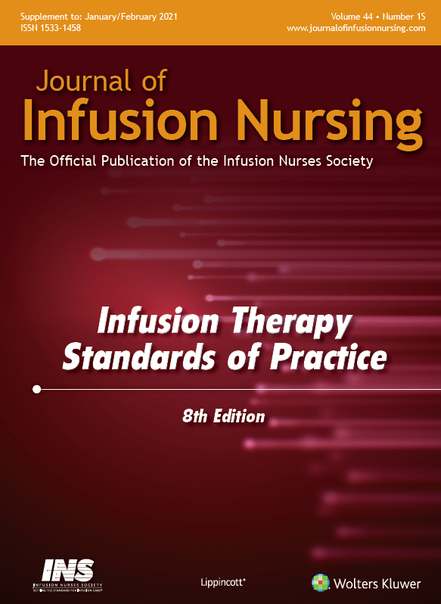
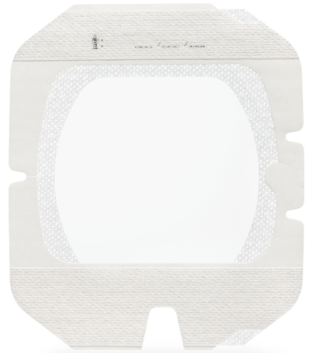
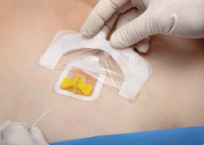
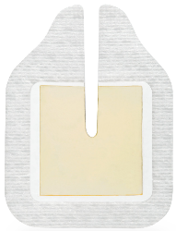
Linee Guida INS
Medicazioni Antimicrobiche - Port
Standard 28, F.3. – Port
Linee guida per l’oncologia suggeriscono l’utilizzo di medicazioni contenenti CHG intorno al sito di inserzione dell’ago in base alla durata delle infusioni, superiore alle 4-6 h. (V)
Gorski LA, Hadaway L, Hagle ME, et al. Infusion therapy standards of practice.J Infus Nurs. 2021;44(suppl 1):S1-S224. doi:10.1097/NAN.0000000000000396

Slide 11
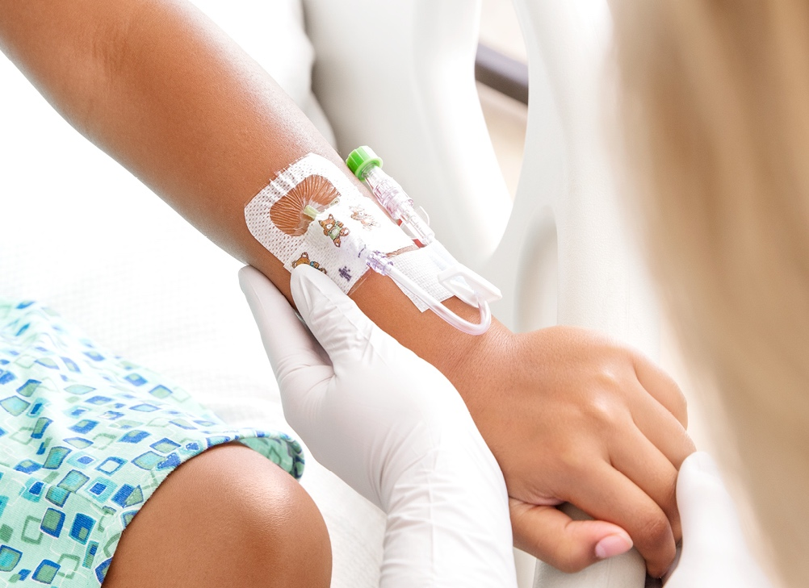
E per la gestione del periferico?
© 3M 2022. All rights reserved. 3M confidential.
11

Slide 12




Le linee periferiche.
L’accesso venoso periferico (PIV) è spesso considerato come una procedura semplice e a basso rischio quando invece:
Fino al
70%
Anche nella maggior parte dei centri con team dedicati agli accessi vascolari che hanno fatto studi clinici prospettici randomizzati, la media di insuccesso del PIV varia da
Di pazienti riceve un catetere PIV durante la degenza ospedaliera¹
46–59%³
7–20 giornate aggiuntive
Il trattamento delle complicanze correlate al catetere possono aumentare le giornate di degenza³
La mortalità a 30 giorni nei pazienti al di fuori delle TI con infezione nosocomiale del sangue catetere correlate con PIVC è di
16–23%⁴⁻⁷
Il costo aggiuntivo per il trattamento di una CRBSI per paziente in Terapia Intensiva varia da
€21–32k
12.7%²
Di tutte le CR-BSIs sono associate a un PIVCs
⁸
⁹
© 3M 2022. All rights reserved. 3M confidential.
12
Notes:
Zingg W, Pittet D. Peripheral venous catheters: an under-evaluated problem. Int J Antimicrob Agents. 2009;34(S4):S38-S42.
2. Saliba P, Hornero A, Cuervo G, Grau I, Jimenez E, García D, Tubau F, Martínez-Sánchez JM, Carratalà J, Pujol M. Mortality risk factors among non-ICU patients with nosocomial vascular catheter-related bloodstream infections: a prospective cohort study. J Hosp Infect. 2018 May;99(1):48-54. doi: 10.1016/j.jhin.2017.11.002. Epub 2017 Nov 8. PMID: 29128346.
3. Helm RE, Klausner JD, Klemperer JD, Flint LM, Huang E. Accepted but unacceptable: Peripheral IV catheter failure. J Infus Nurs. 2015;38(3):189-203.
4. NRZ Deutsche nationale Punkt-Prävalenzerhebung zu nosokomialen Infektionen und Antibiotika-Anwendung 2016 Abschlussbericht, https://www.nrz-hygiene.de/fileadmin/nrz/download/pps2016/PPS_2016_Abschlussbericht_20.07.2017.pdf
5. Résultats de la surveillance nationale 2019, REPIAS, SPIADI. Accessible at https://www.spiadi.fr/results?tab=0
6. Mermel L. Short-term Peripheral Venous Catheter-Related Bloodstream Infections: A Systematic Review. Clin Infect Dis. 2017;65(10):1757-1762.
7. Saliba P, Hornero A, Cuervo G, Grau I, Jimenez E, Berbel D, Martos P, Verge JM, Tebe C, Martínez-Sánchez JM, Shaw E, Gavaldà L, Carratalà J, Pujol M. Interventions to decrease short-term peripheral venous catheter-related bloodstream infections: impact on incidence and mortality. J Hosp Infect. 2018 Nov;100(3):e178-e186. doi: 10.1016/j.jhin.2018.06.010. Epub 2018 Jun 19. PMID: 29928942.
8. Leistner R, Hirsemann E, Bloch A, Gastmeier P, Geffers C. Costs and prolonged length of stay of central venous catheter-associated bloodstream infections (CVC BSI): a matched prospective cohort study. Infection. 2014;42(1):31‐36. doi:10.1007/s15010-013-0494-z
9. Trautmann M, Saatkamp J, Cost-effectiveness analysis of an antimicrobial transparent dressing for catheter insertion sites on intensive care units; Hyg Med 2016:41(5):D65-70

Slide 13
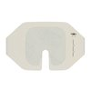

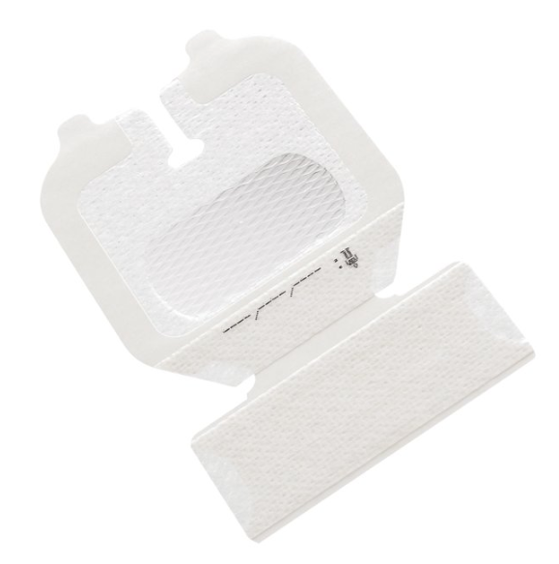
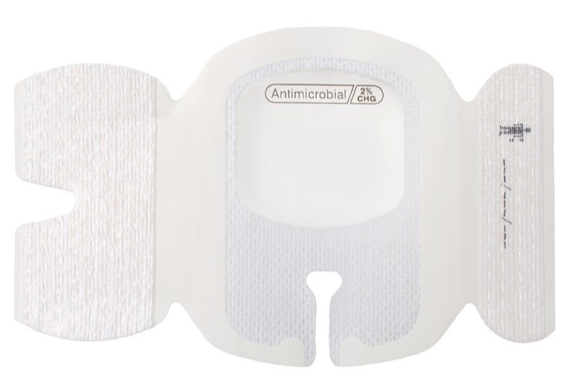
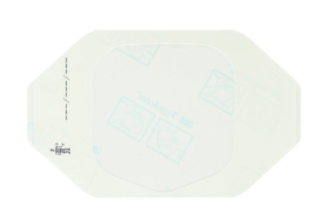
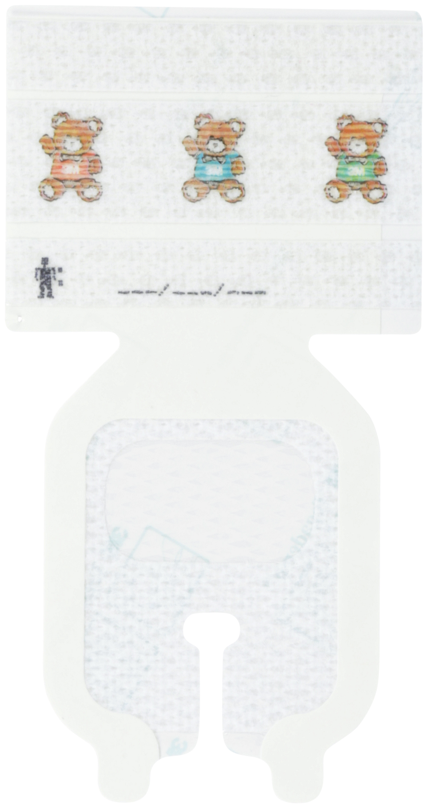
L’evoluzione delle medicazioni per periferico
3M™ Tegaderm™
Dressing
3M™ Tegaderm™
I.V. Dressing
3M™ Tegaderm™ I.V.
Adv. Sec. Dressing
3M™ Tegaderm™ Antimicrobial
I.V. Adv. Sec. Dressing
Protezione Antimicrobica
Suppression of regrowth
of skin flora at 1, 3, and
7 days.
Fissaggio catetere avanzato
Full border, advanced moisture management, engineered tapes strips
and ANTT application.
Stabilizzazione catetere
Reinforced notch with
a soft cloth area and
2 additional tape strips.
Protezione catetere e trasparenza
Waterproof, sterile barrier to external contaminants
and a 7-day wear time.
Nuova categoria
*full reinforced soft-cloth border, additional tape strips or single large notched stabilisation tape strip, key-hole notch design.
Notes:
We have many different dressings for applying on peripheral catheters. Because we do have many different customer situations.
In a perfect world, every customer would want to use the strongest antimicrobial protection on all of their PIVs. Regardless of whether it is a peripheral line or a central line, it is all the same bloodstream.
But, not every customer is ready for that. This requires a change of practice and a change in how they view PIVs.
While all of dressings will offer basic protection and site visibility, advanced securement features will only apply to our Tegaderm™ IV Advanced Securement dressings, available in pediatric sizes, and 1-handed and 2-handed application options.
Our new dressing adds to these advanced securement features the antimicrobial agent CHG included in the adhesive, in 2% concentration on the surface of the window. This will limit the growth of skin flora on the skin
As 3M, we should advise our customers on best practices and that means we should encourage a wide use of 9132. After all, why shouldn’t every patient receive the best standard of care?
If a customer is not ready for antimicrobial on PIVs, then 1681/1683 are great alternatives.

Slide 14
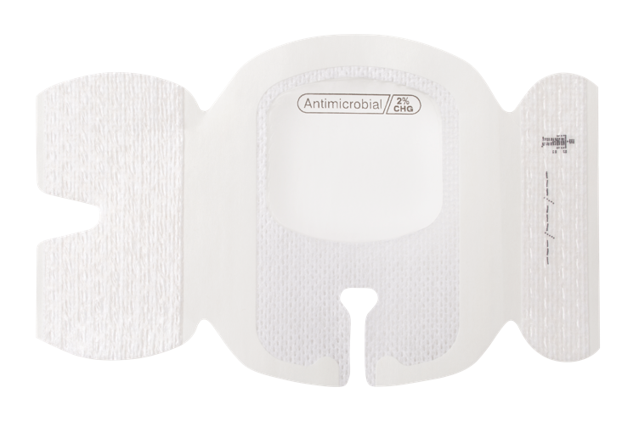
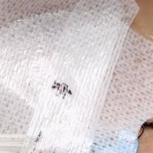
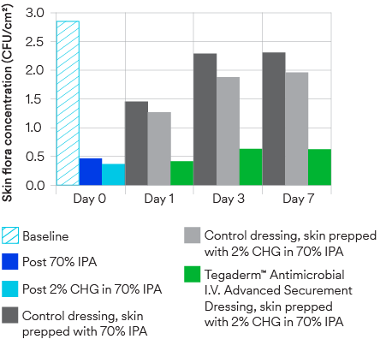
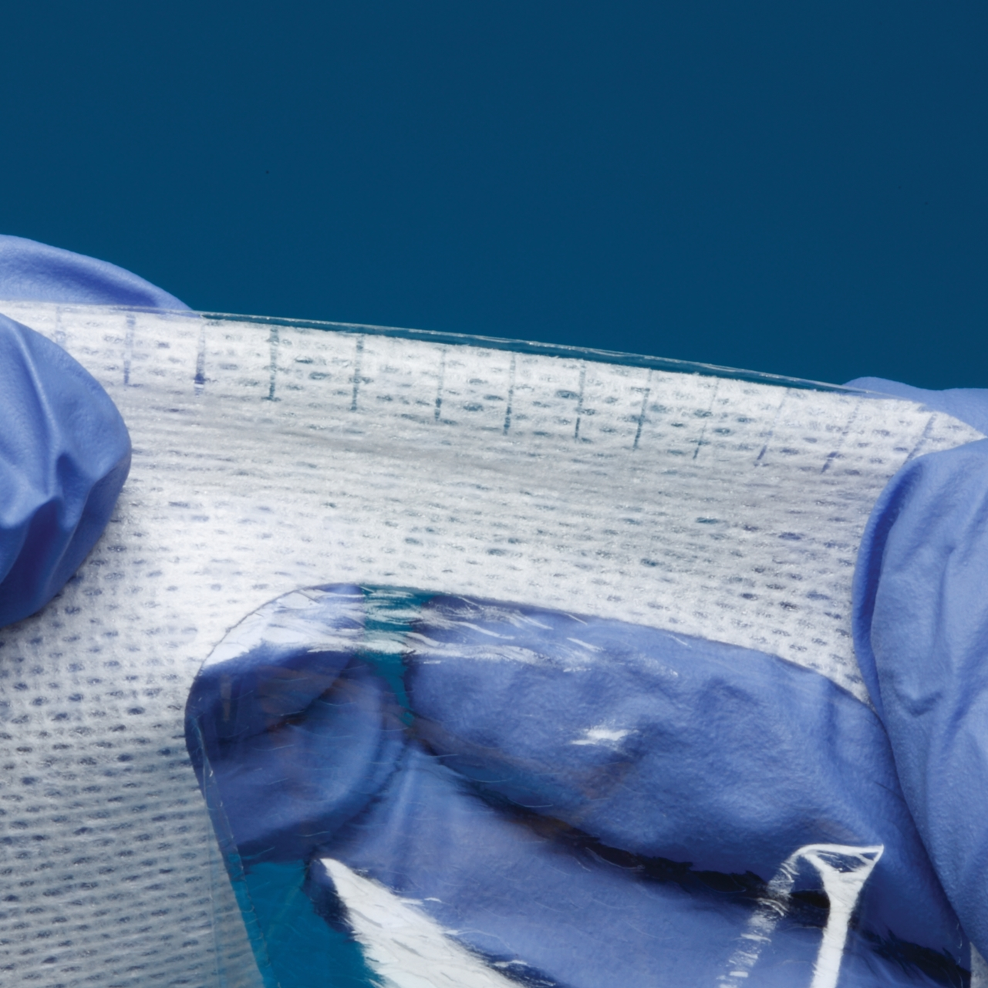
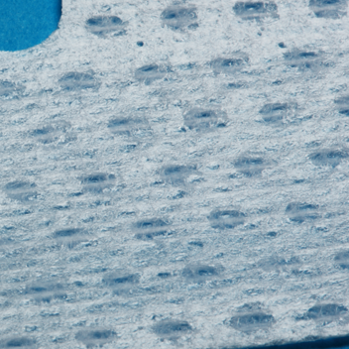
3M™ Tegaderm™ Antimicrobial I.V.
Advanced Securement Dressing 9132.
Nuovo prodotto!
Introducing 3M™ Tegaderm™ Antimicrobial I.V. Advanced Securement Dressing 9132 as part of the solution. Integrated design combines antimicrobial protection with site visibility, catheter securement and consistent application for peripheral IVs.
A waterproof, sterile
barrier protects against external contaminants*
Breathable, transparent film.
Antimicrobial protection
Chlorhexidine gluconate (CHG)
is formulated into the dressing adhesive to provide antimicrobial protection. No additional moisture is required to activate.
Antimicrobial protection
Suppresses the regrowth of skin flora on prepped skin better than non-antimicrobial dressings.³⁵
Large securement tape strip with notch
Promotes consistent application and enhances stabilisation.
Conforming
keyhole notch
A notch allows catheter lumens to fit better and stay in place.
Conforming edge border
Uses technology designed to reduce edge-lift.
*In vitro testing shows that the film provides a barrier against viruses 27 nm in diameter or larger while the dressing remains intact without leakage.
Notes:
*In vitro testing shows that the film provides a barrier against viruses 27 nm in diameter or larger while the dressing remains intact without leakage.
35. 3M data on file. EM-05-305455

Slide 15
Grazie

Slide 16
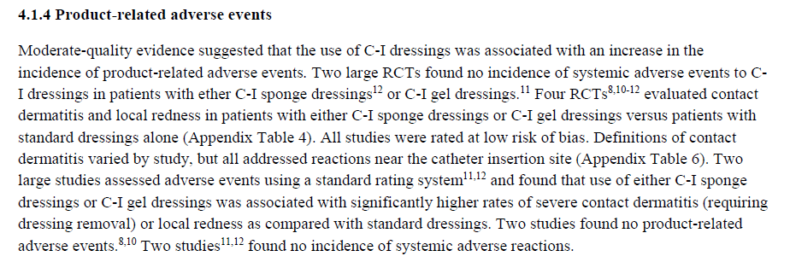
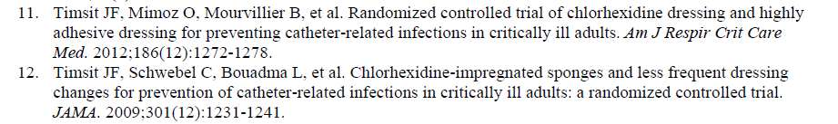
Reazioni cutanee & Letteratura

Slide 17
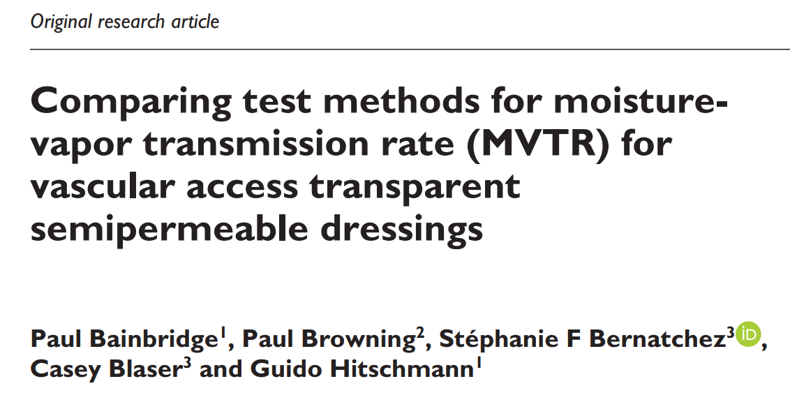
MVTR
Bainbridge et al
There is currently no clinical evidence indicating a correlation between a higher MVTR value and a lower rate of catheter-related infection for the IV dressings in use today.
Current guidelines do not favor a type of transparent dressing over another for IV site applications and clinical practice should focus on choosing a dressing that will adhere well and provide good visibility to the IV site.
We postulate that as long as the MVTR value (upright method) of an IV dressing is sufficient to prevent accumulation of moisture under the dressing, any increase above this threshold value will not bring additional benefits.

Slide 18
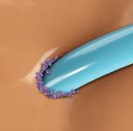
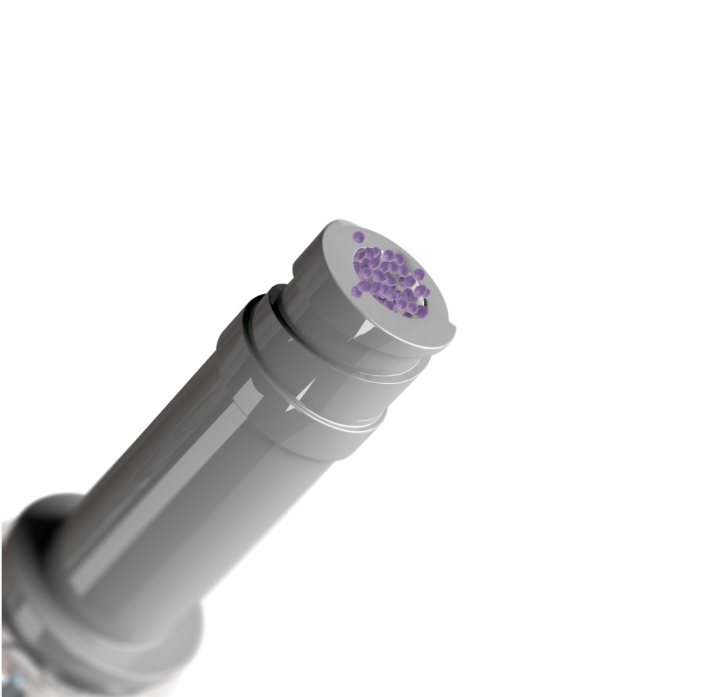
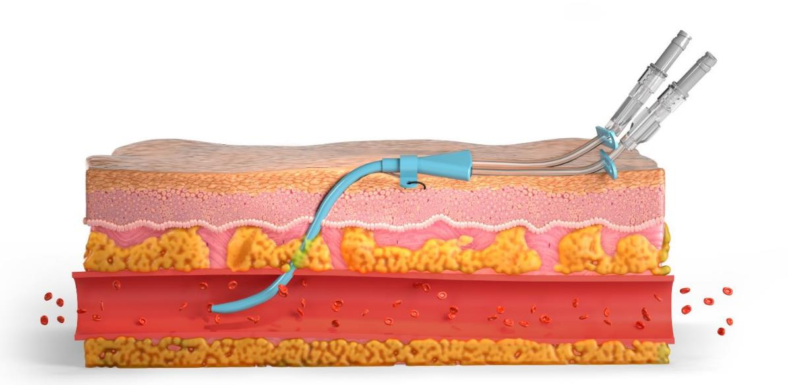
La maggior parte delle CRBSI proviene dal sito di inserzione o dall'hub del catetere^{22–25}
I microrganismi presenti sulla cute del paziente penetrano nel flusso sanguigno percorrendo la superficie esterna e l'hub dei cateteri; entrambi rappresentano due importanti vie di infezione del flusso sanguigno correlate al catetere.^{23–26}
Subito dopo l’impianto, il percorso extraluminale o il sito di inserzione è la fonte predominante di infezione^{23,27,28}
Il percorso intraluminale
(principalmente l'hub) prevale
dopo un tempo di permanenza più prolungato²⁹⁻³⁰
Notes:
Sources:
Mermel LA, Allon M, Bouza E, et al. Clinical practice guidelines for the diagnosis and management of intravascular catheter-related infection: 2009 update by the Infectious Diseases Society of America. Clin Infect Dis. 2009; 49(1): 1-45.
Safdar N, Maki DG. The pathogenesis of catheter-related bloodstream infection with noncuffed short-term central venous catheters. Intensive Care Med. 2004; 30(1): 62-67.
Mermel LA. What is the predominant source of intravascular catheter infections? Clin Infect Dis. 2011; 52(2): 211-212.
Maki DG, Stolz SM, Wheeler S, Mermel LA. Prevention of central venous catheter-related bloodstream infection by use of an antiseptic-impregnated catheter: A randomized, controlled trial. Ann Intern Med. 1997; 127(4): 257-266.
Dittmer ID, Sharp D, McNulty CA, Williams AJ, Banks RA. A prospective study of central venous hemodialysis catheter colonization and peripheral bacteremia. Clin Nephrol. 1999; 51(1): 34-39.
Mermel LA, McCormick RD, Springman SR, Maki DG. The pathogenesis and epidemiology of catheter related infection with pulmonary artery Swan-Ganz catheters: A prospective study utilizing molecular subtyping. Am J Med. 1991; 91(36):197S–205S.
Maki DG, Weise CE, Sarafin HW. A semiquantitative culture method for identifying intravenous-catheter-related infection. N Engl J Med. 1977; 296(23): 1305-1309.
Segura M, Lladó L, Guirao X, Piracés M, Herms R, Alia C, Sitges-Serra A. A prospective study of a new protocol for ‘in situ’diagnosis of central venous catheter related bacteraemia. Clin Nutr. 1993; 12(2): 103-107.
Raad I, Costerton W, Sabharwal U, Sadlowski M, Anaissie E, Bodey GP. Ultrastructural analysis of indwelling vascular catheters: a quantitative relationship between luminal colonization and duration of placement. J Infect Dis. 1993; 168(2): 400-407.
The majority of infections are caused by contamination which enters the bloodstream from either the insertion site or the catheter hub. When infections occur shortly after catheter insertion, the most common source is the insertion site, also known as the extraluminal route.
When the infection occurs after an extended catheter dwell time, the most common source is the catheter hub or access point, also known as the intraluminal route. (Specific duration of catheter dwell time (number of days) and source of contamination (extraluminal versus intraluminal) vary by study).
Sources:
Mermel LA, Allon M, Bouza E, et al. Clinical practice guidelines for the diagnosis and management of intravascular catheter-related infection: 2009 update by the Infectious Diseases Society of America. Clin Infect Dis. 2009; 49(1): 1-45.
Safdar N, Maki DG. The pathogenesis of catheter-related bloodstream infection with noncuffed short-term central venous catheters. Intensive Care Med. 2004; 30(1): 62-67.
Mermel LA. What is the predominant source of intravascular catheter infections? Clin Infect Dis. 2011; 52(2): 211-212.
Maki DG, Stolz SM, Wheeler S, Mermel LA. Prevention of central venous catheter-related bloodstream infection by use of an antiseptic-impregnated catheter: A randomized, controlled trial. Ann Intern Med. 1997; 127(4): 257-266.
Dittmer ID, Sharp D, McNulty CA, Williams AJ, Banks RA. A prospective study of central venous hemodialysis catheter colonization and peripheral bacteremia. Clin Nephrol. 1999; 51(1): 34-39.
Mermel LA, McCormick RD, Springman SR, Maki DG. The pathogenesis and epidemiology of catheter related infection with pulmonary artery Swan-Ganz catheters: A prospective study utilizing molecular subtyping. Am J Med. 1991; 91(36):197S–205S.
Maki DG, Weise CE, Sarafin HW. A semiquantitative culture method for identifying intravenous-catheter-related infection. N Engl J Med. 1977; 296(23): 1305-1309.
Segura M, Lladó L, Guirao X, Piracés M, Herms R, Alia C, Sitges-Serra A. A prospective study of a new protocol for ‘in situ’diagnosis of central venous catheter related bacteraemia. Clin Nutr. 1993; 12(2): 103-107.
Raad I, Costerton W, Sabharwal U, Sadlowski M, Anaissie E, Bodey GP. Ultrastructural analysis of indwelling vascular catheters: a quantitative relationship between luminal colonization and duration of placement. J Infect Dis. 1993; 168(2): 400-407.

Slide 19
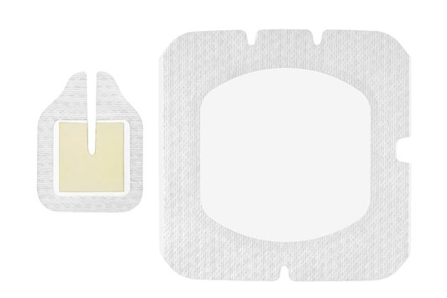
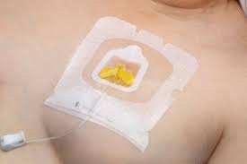
3M™ Tegaderm™ CHG I.V. Port Dressing 1665
© 3M
Notes:
The 3M™ Tegaderm™ CHG Chlorhexidine Gluconate I.V. Port Dressing is an antimicrobial (CHG) gel pad plus I.V. port dressing that’s specifically designed to protect single or double implanted venous ports and non-coring needles. Let’s take a closer look at some of the key features and benefits.

