Slide 1


IV CONGRESSO NAZIONALE IVAS
10 - 11 Novembre 2023
Stato dell’arte delle infezioni catetere correlate
Alessandra Micozzi
Dipartimento di Medicina Traslazionale e di Precisione
Sapienza Università di Roma

Slide 2
Gilead
Pfizer
NORDIC Pharma
BD

Slide 3
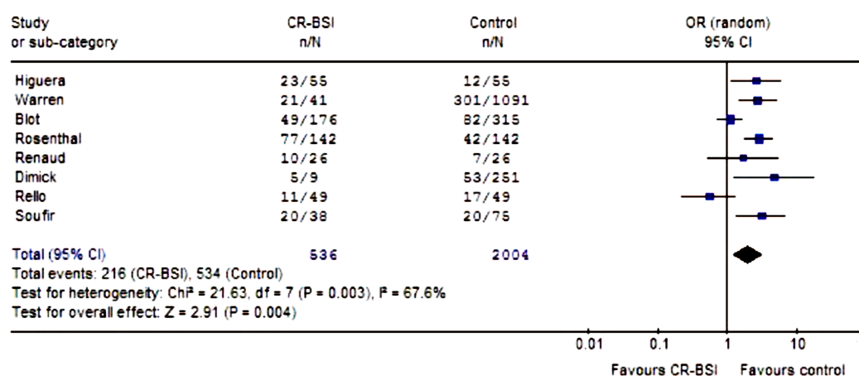


Background
Intravascular catheters are inserted into almost all critically ill patients, essential for the effective treatment
The major concern with CVCs is colonization by microorganisms and the subsequent catheter related BSI.
CR BSIs are still a common problem, especially in the most severely ill population
CR BSIs have a significant impact on morbidity, mortality and costs
CRBSI presence is associated with higher mortality in critically ill adult patients

Slide 4
CRBSI and CLABSI definitions
CRBSI (Catheter-related BSI)
more often used for research
it requires specialized microbiological techniques to specifically identify the catheter as the source of bacteremia
  Semiquantitative or quantitative culture from a catheter segment with the same organism isolated from a blood culture
  Simoultaneous quantitative blood cultures (3:1 ratio CFU/ml CVC vs peripheral)
  Differential time positivity (difference no > 2 h CVC vs peripheral)
CLABSI (Central-line associated BSI)
a simplified definition based on surveillance criteria
identify BSI in patients with CVCs in which there is no other source for BSI
Risk of overestimation
In every patient with an indwelling CVC, the documentation of a bacteremia raises doubts whether the CVC is involved in the infection

Slide 5
Incidence of CRBSI
The incidence of CRBSI varies depending on:
  the patient population, type of device, intended use for the device, insertion site, duration of placement, frequency which the catheter is accessed
  adherence to recommendations based on up-todate and high quality clinical evidence
The incidence of CRBSI has decreased in developed countries:
implementation of bundles for prevention
increased adherence to better catheter care and maintenance
        USA: 46% reduction in CLABSI rates between 2008 and 2013
        CLABSI risks have fallen to approximately 1.65 per 1000 central line days
        30.100 CLABSIs/years still occur in ICU and acute care wards
        Economic burden with costs estimated to be 45,108 USD per event
        Europe: estimated between 8.400 to 14.400 episodes of CRBSI/year
        hospital costs directly attributed to the onset of CLABSI were 8,810 € per case (DE)
        annual costs between 36 to 164 million €

Slide 6
PICC
Use of PICCs in hospitalized patients and patients requiring long-term venous access has increased substantially during the past decade
PICCs offer a number of advantages
  safer insertion (avoiding pneumothorax)
  convenient placement by nurse-led vascular access teams;
  clinical advantages in specific patients where CVC placement is more challenging (patients with coagulopathies, morbid obesity, head and neck injuries)
PICC-related CLABSI rates: 2.4-4.2/1000 catheter days

Slide 7
Systematic review and meta-analysis (2013):
PICCs were associated with a lower risk of CLABSI than were CVCs
  greatest in outpatients
  PICC-related CLABSI per catheter-day occurred as frequently as CVC-related CLABSI
Chopra Infect Control Hosp Epidemiol 2013
PICCs and CLABSI
PICU setting:
1660 devices in 1255 children: 922 PICCs 738 CVCs
overall CLABSI incidence: 2.28/1000 catheter-days
CVCs were associated with higher risk of CLABSI (adj HR 2.20, 95% CI 1.05–4.61; p = 0.037).
Silveira Yamaguchi Intensive Care Med (2017)
Adult setting
20.104 pts with PICC, 4775 patients with CVC
Pts with CVC:
higher crude CLABSI rate (5.55 vs 0.84/1000 cath days)
higher 30-days CLABSI hazard.
Lv et al BMC Infect Dis 2022

Slide 8
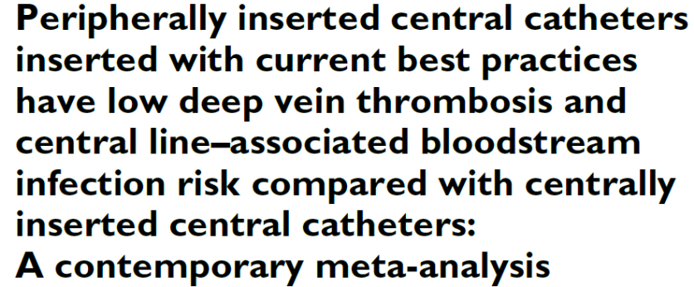
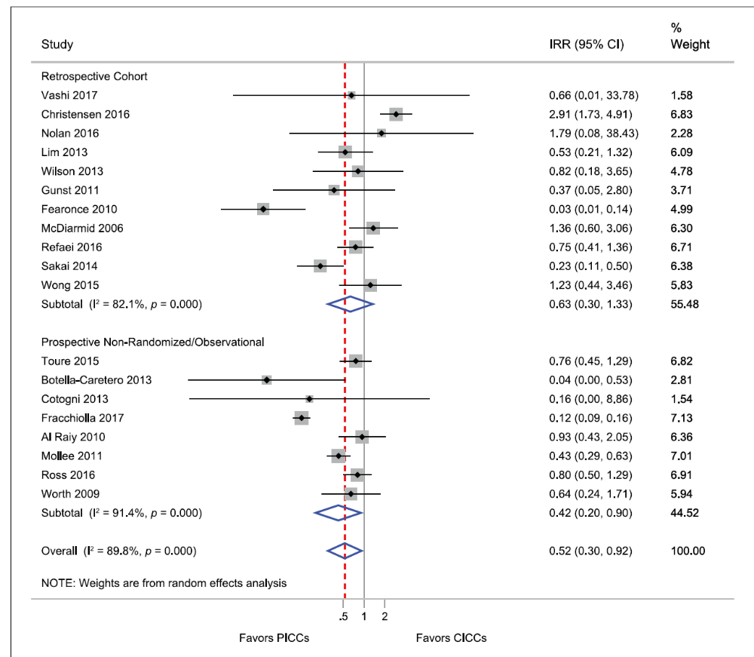


2021
Dramatic changes to clinical practice over the last 10 years have helped to address past issues with central catheters and complication risk.
Lower rate of complications when following current guidelines.
When adhering to best practices that concerns related to PICC risk are minimized (deep vein thrombosis and CLABSI).
Clinicians should prioritize central line choice based on patient therapeutic needs, rather than fear of complications.

Slide 9

Risk factors for infection
Indipendent factors associated with PICC-R BSI:
  ICU
  length of stay (hospital and ICU)
  number of PICC lumens (double and triple lumen)
  erlier infections
  Chopra et al. 2014 Am J Med
Patient factors: immunosuppression increases the risk
The cumulative risk of infection increases with the number of days the CVC is in place
Prompt removal of unnecessary CVCs is mandatory
Assess and discuss with the health care team the continued need for the CVAD on a daily basis and remove when it is no longer needed for the plan of care.
observational study on PICC from placement until removal:
24% had complications
A higher proportion of pts with confirmed or suspected CLABSI:
  received TPN
  dual-lumen catheters (P =.04)
  were neutropenic
    Liscynesky, et al AJIC 2017
Rates of CLABSI in pts with 1 vs 2 CVC
Concurrent CVC use is associated with 2-fold the risk of CLABSI compared to a single CVC use
    Dube et al Jama NO 2020

Slide 10
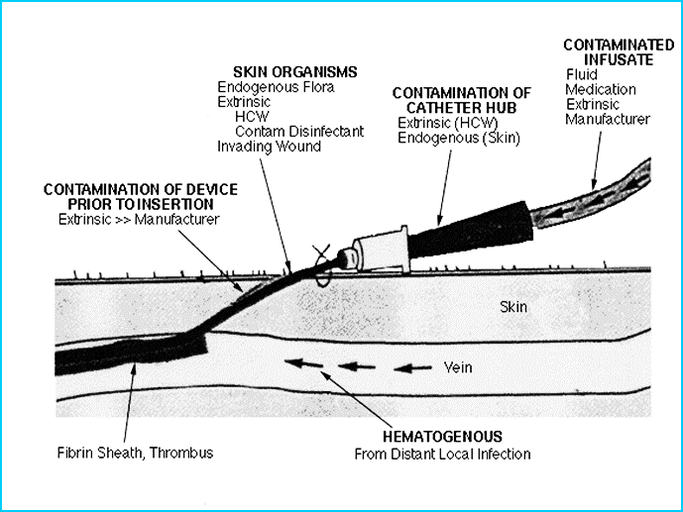
Epidemiology of CRBSI
Epidemiologic shift:
Increase in the rate of gram-negative CRBSI (cancer pts)
Reduction in the contribution of the catheter as the source of BSI (wide implementation of preventive interventions)
Overall increase in gram-negative BSI and colonization (MDR)
Increased use of antimicrobial CVCs (which mainly cover gram-pos organisms)
in the late 20th century:
the catheter was the leading source of the BSIs
70% of CRBSI were due to gram-positives
biofilm-forming coagulase-negative Staphylococci were the leading
cause of CRBSI
Sources of CVC colonization or infection

Slide 11
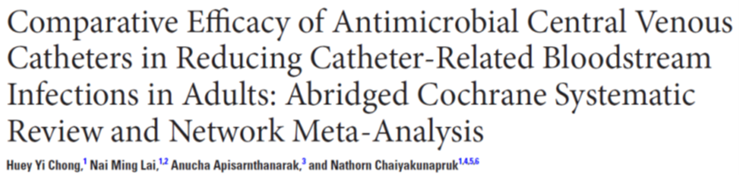


effectiveness of antimicrobial CVCs in reducing rates of CRBSI and catheter colonization
2018
antimicrobial CVCs reduce CRBSI and catheter colonization rates
  benefits regarding catheter colonization only in ICUs
No significant reduction in clinically diagnosed sepsis or mortality small body of evidence
call for caution in routinely recommending the use of antimicrobial-impregnated CVCs across all settings.
  .
minocycline-rifampicin impregnated CVC appears to be the most effective in preventing CRBSI.
overall benefits in reducing clinical sepsis and mortality remain uncertain.
surveillance for antibiotic resistance attributed to the routine use of antimicrobial-impregnated CVCs should be emphasized in future trials

Slide 12
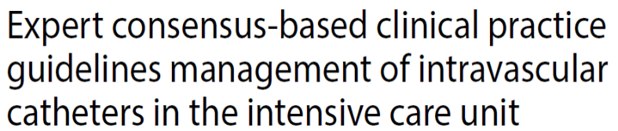

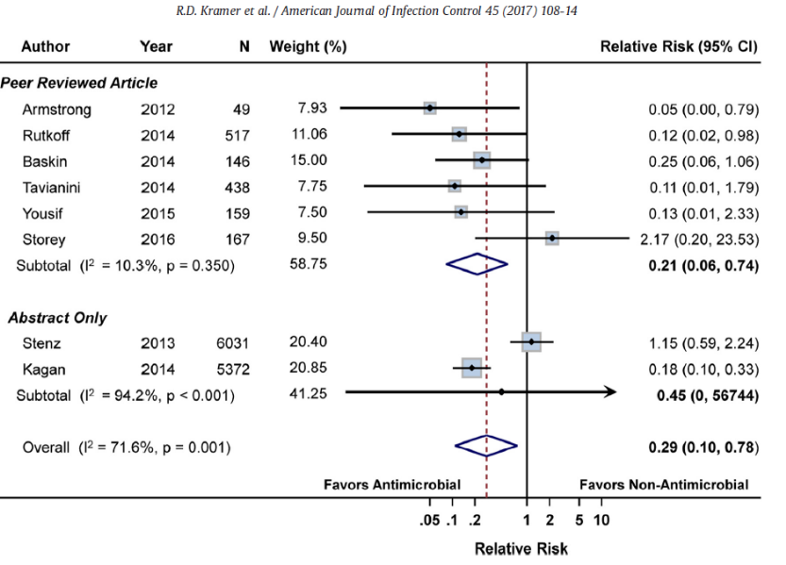

antimicrobial PICCs?
Systematic review and meta-anlysis
most significant benefits of using antimicrobial catheters:
  in settings that are higher risk for CLABSI (ICU) than in settings in which the risk for CLABSI is low (general ward).
  in areas in which CLABSI rates remain higher than institutional goals
problems
  antibiotic resistance
  additional costs
Antimicrobial (antiseptic or antibiotic) CVC should probably not be used to decrease the incidence of BSI
Antimicrobial PICCs were associated with a significant reduction in CLABSI especially in high risk subgroups.
  greater in adults at greater baseline risk of CLABSI
  NNT with antimicrobial PICCs to prevent 1 CLABSI: 26
Use an antimicrobial catheter to reduce the risk of CABSI in at-risk patients, such as those in ICUs
2021

Slide 13
CRBSI treatment
Removal:
IDSA guidelines (2009)
Complicated infections (tunnell, porth, endocarditis, septic thrombosis)
High risk level (clinical)
S.aureus, gram-negatives, Candida
ASCO guidelines (2013)
Complicated infections (tunnell, porth, endocarditis, septic thrombosis)
Fungi, mycobacteria, gram-negatives
Persistent bacteremia
INS guidelines (2021)
clinical deterioration or persisting or relapsing bacteremia
Staphylococcus aureus, gram-negatives, Candida (except in rare circumstances when no alternative vascular access is possible)
Difficult: adherence, biofilm, antimicrobial resistance
Catheter removal is the main therapeutic intervention and always recommended, especially in the case of sepsis or shock.

Slide 14
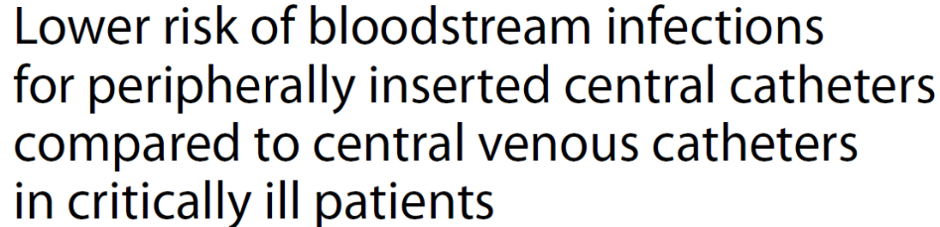
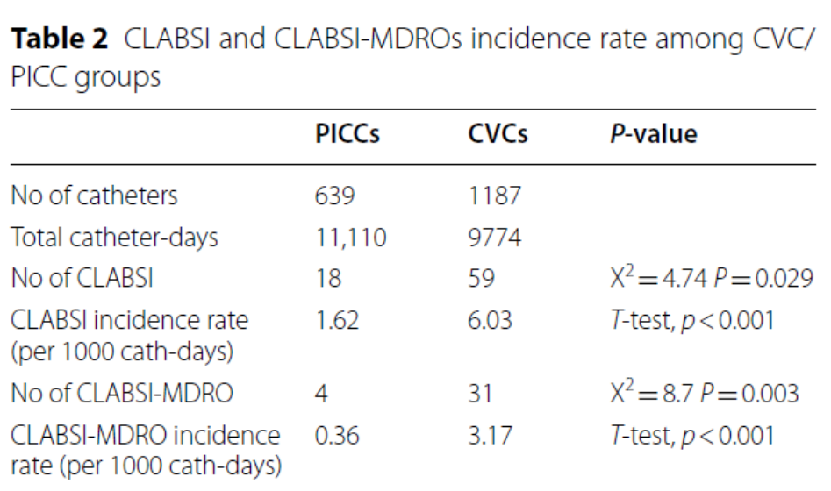
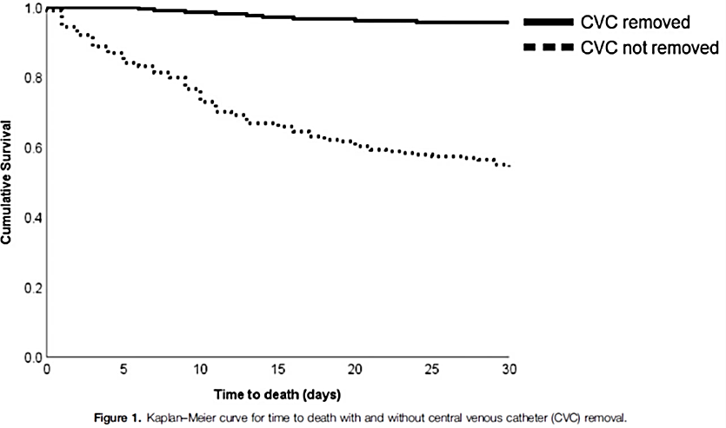

MDR organism CLABSI
For patients whose CVC remained in place, 45.3% died within 30 days of culture
Failure to remove a CVC was significantly associated with 30-day all-cause mortality
Burnham et al. Medicine, 2018; 97:42

Slide 15
Premature CVAD Removal
312 PICCs in 144 neutropenic acute leukemia patients
premature PICC removal: 33% (18% CRBSI)
the easy procedure of PICC insertion allowed a new placement in patients who underwent anticipate PICC removal, even during aplasia.
  Bruzzese et al. Leuk Lymph 2020
100 PICCs in allo HSCT
premature PICC removal: 32%
78% of patients who developed a CRBSI responded to antibacterial treatment and PICC removal was postponed after engraftment at neutrophils recovery
  Mariggiò et al Supp Care Cancer 2020
Removal before completion of their intended therapy may led to serious problems
  Frequent need for subsequent reinsertions (critically ill patients)
accurate CRBSI diagnosis with catheter in place are an attractive option (diagnostic techniques)

Slide 16

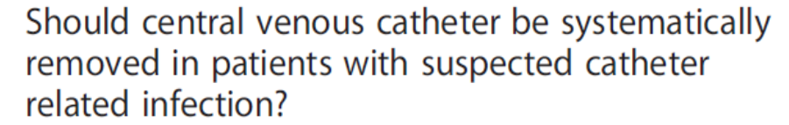
Confirmed CRBSI
Retention:
IDSA guidelines (2009)
Uncomplicated infections
coag-neg Staphylococcus, Enterococcus
ASCO guidelines (2013)
coag-neg Staphylococcus, Enterococcus
Response to appropriate therapy
INS guidelines (2021)
hemodynamically stable patients when a CABSI is confirmed
uncomplicated CABSI
short-term CVAD (in situ ≤14 days) (systemic antibiotics for 7 to 14 d).
long-term CVAD colonized with coag-neg Staph or Enterococcus (systemic antibiotics and antibiotic lock therapy)
Do not remove a functioning CVAD solely on suspicion of infection
Consider:
Patients: age, venous integrity, underlying condition/disease (immunocompromised, burns, transplants)
type of CVAD (long-term vs short-term)
Confirmed or suspected infection
infecting organism
Availability of alternative vascular access options
Catheter status and history
multicenter, observational study, 18 Spanish ICU
patients with suspected CRBSI
No significant differences between survivors and non-survivors at 30 days according to CVC removal decision (P =0.26).

Slide 17
Antimicrobial Treatment of CRBSI
Empiric while awaiting culture confirmation:
should target S. aureus
should be based on clinical variables
        patients risk factors, previous colonization status, epidemiology (ward, hospital, country)
  Empiric coverage for gram-neg
Risk factors for P.aeruginosa and MDR gram-neg:
    previous infection, critical ilness, neutropenia, prior antibiotics, femoral catheter
  Empiric coverage for candidemia (echinocandin)
multiple sites are colonized with Candida spp
patients are receiving TPN
prolonged administration of broad-spectrum ATB
Duration of antimicrobial therapy
uncomplicated CRBSI is controversial depending on the causative pathogen
following catheter removal:
  may not need to exceed 7–10 days (for low virulence organisms is not known
complicated CRBSI (positive blood culture after 72h of therapy)
  Endocarditis and thrombophlebitis are the most common causes of failure
  S. aureus CRBSI requires a high index of suspicion for endocarditis and metastatic infections

Slide 18
Management of the catheter in documented catheter-related coagulase-negative Staphylococcal bacteremia:
Remove or Retain?
Treatment of Gram-positive CRBSI
Vancomycin represents the cornerstone
Excessive vancomycin usage has contributed to high vancomycin MIC (>1.0 microg/mL), associated with poor outcome in patients with MRSA infection.
there is a need for an alternative agent:
Daptomycin compared to vancomycin resulted
  more efficacious in inhibiting MRSA in biofilm
  the fastest in eradicating MRSA from biofilm
  Raad, Antimicrob Agents Chemother. 2007
Daptomycin treatment of Gram-pos CRBSI in cancer pts
  significantly associated with earlier clinical and microbiological response
  improved overall response
    Chaftari, Int J Antimicrob Ag 2010
Daptomycin treatment of Gram-positive CRBSI in haematological pts
  CVC salvage in 61% of CRBSI
  Delayed CVC removal in 30% of CRBSI
    Micozzi ICAAC 2011
Gram-positive CRBSI
Resolution of infection within 48 h after commencement of antimicrobial therapy occurred in the 93% of patients not influenced by CVC removal versus retention
Patients with catheter retention were 6.6 times more likely to have a recurrence than were those whose catheter was removed (p.004).
Conclusions. CVC retention does not have an impact on the resolution of coagulase-negative staphylococcal bacteremia but is a significant risk factor of recurrence.
I.Raad CID 2009

Slide 19
Conclusions
Insertion and maintenance bundles have been developed to prevent microbial colonization of CVC thereby mitigating risk of CRBSI.
Implementation of bundles has been demonstrated to reduce the incidence of CLABSI by 52%
CRBSI and premature CVC removal can have dramatic consequences
Early interdisciplinary communication essential to facilitate the management of complications:
  the exclusion of non catheter-associated sources of fever
  early diagnostic techniques for CRBSI aimed to avoid unnecessary catheter removal should be investigated
  the appropriate management of catheter occlusion, rupture, or partial unintentional removal without removal

