Slide 1
Central Venous Accesses: rationalising the use of technology
Meet the Experts: Drive to Zero.
Prof. Baudolino Mussa
5th October, 2023

Slide 2
Disclosure
Prof. Mussa has been paid by Teleflex for this presentation.

Slide 3
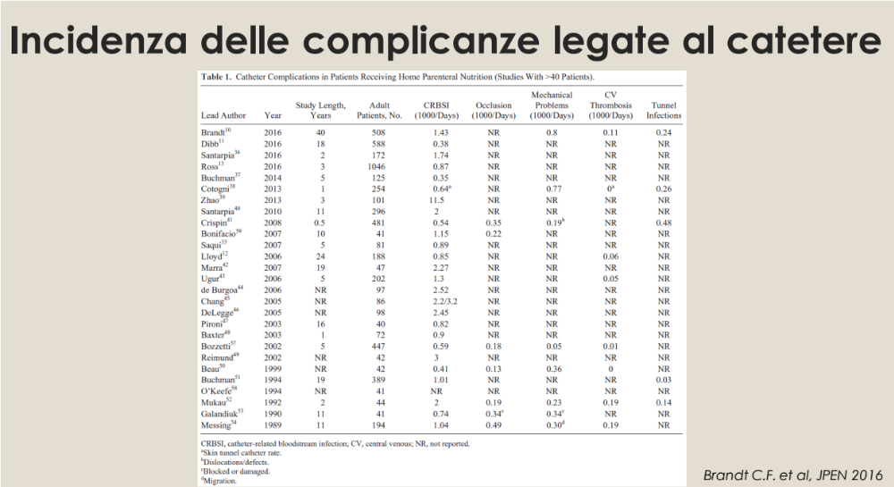
Meet the Experts

Slide 4
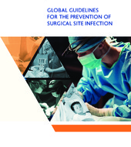
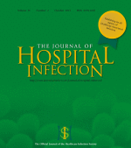
Importance of SSI
Healthcare-Acquired Infections (HAIs), among which Surgical Site Infections (SSIs) are among the most frequent and cause a prolonged hospital stay, long-term disability, an additional economic burden for healthcare systems, patients and their families, and a significant increase in mortality.
Meet the Experts

Slide 5
Definition ISS
The European Centre for Disease Prevention and Control (ECDC) has established that surgical site infections are postoperative infections that occur within 30 days after a surgical procedure or within one year after the implantation of a permanent device.
Meet the Experts

Slide 6
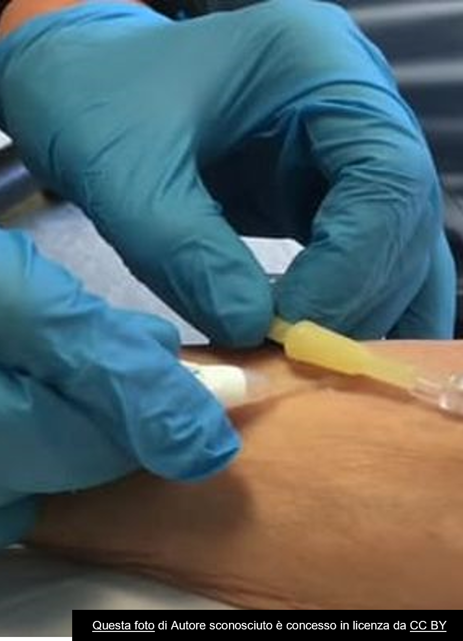
Areas of action in ISS prevention
Vascular access implantation procedure
Every year, 32 million patients in Italy undergo implantation of a short- or long-term vascular access.
Meet the Experts

Slide 7
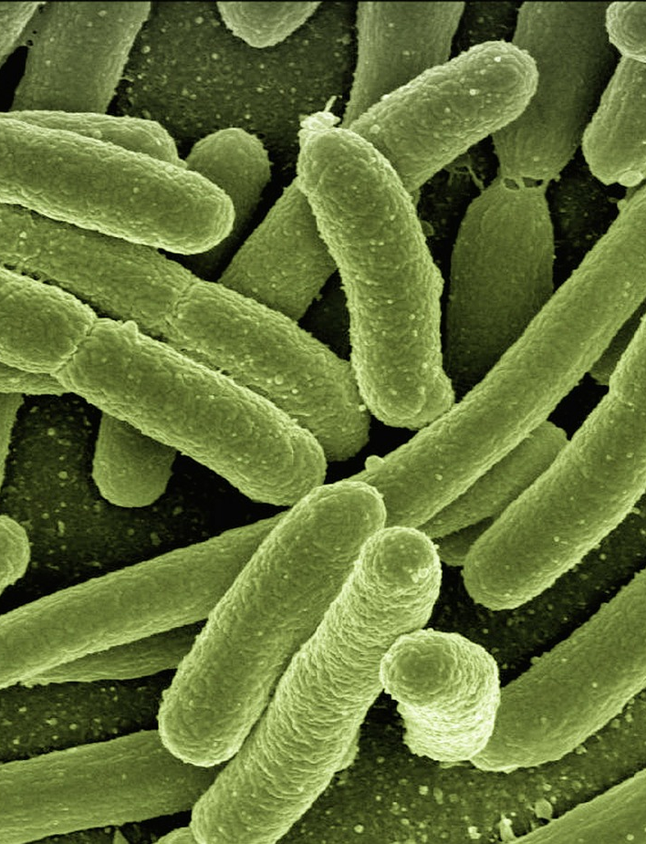
ISS Prevention
Human skin harbours up to 106 bacteria per cm2, most of which (80%) are found in the first five superficial cell layers of the epidermis. Whether through a surgical incision or the insertion of a vascular access, the procedure disrupts the integrity of the skin and its barrier function against infection.
Meet the Experts
Questa foto di Autore sconosciuto è concesso in licenza da CC BY-NC-ND

Slide 8
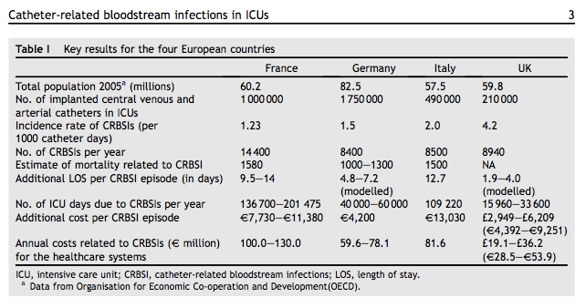
The impact of CRBSI
Meet the Experts

Slide 9
CDC-approved antiseptics
70% Isopropyl Alcohol
Non-persistent effect on skin
Povidone-iodine
must dry completely to release free iodine at 1% (2-3 minutes)
antimicrobial effect is activated
Inactivated in the presence of organic material such as blood or exudates
Chlorhexidine
Persistent by binding to skin proteins
Active for up to 48 hours
Chlorhexidine at 2% in 70% isopropyl alcohol is superior to both alcohol and povidone iodine
Meet the Experts
Notes:
Vediamo quali sono gli antisettici approvati dalle linee guida dei CDC e quindi possiamo parlare dell’alcool isopropilico, del povidone-iodato e della clorexidina.
Ma questi antisettici on sono tutti uguali, la clorexidina si lascia sicuramente preferire grazie ad un effetto che insorge più velocemente e che è più persistente

Slide 10
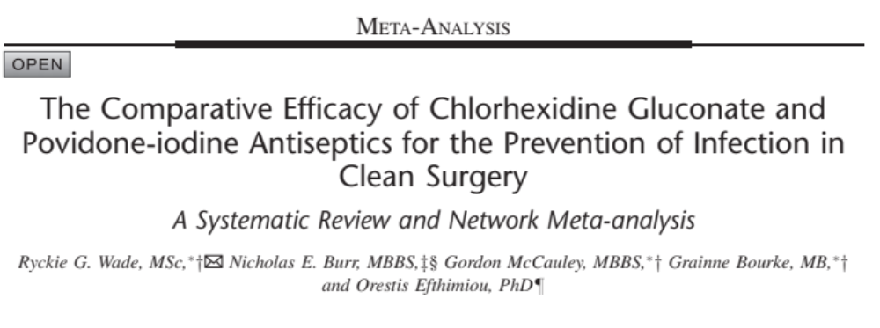


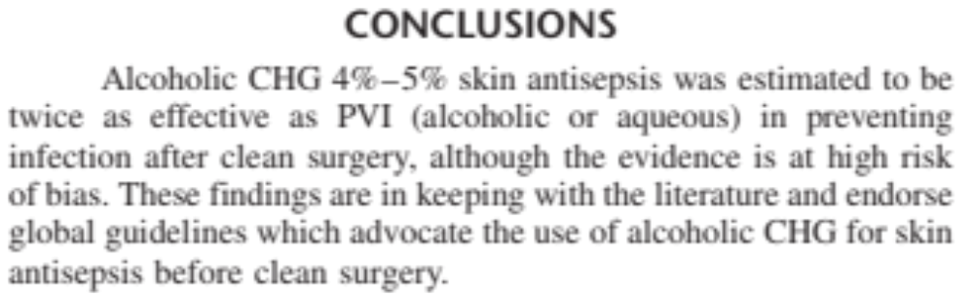
Questa foto di Autore sconosciuto è concesso in licenza da CC BY-SA-NC
Meet the Experts

Slide 11
The problem today is not 'What to do' but rather 'How to do it?'
Meet the Experts
Notes:
… e questo è sicuramente un risultato raggiungibile con gli strumenti giusti per cui il problema oggi, con tutte le linee guida disponibili, non è cosa fare, questo lo si sa o comunque è facile saperlo, ma come farlo

Slide 12
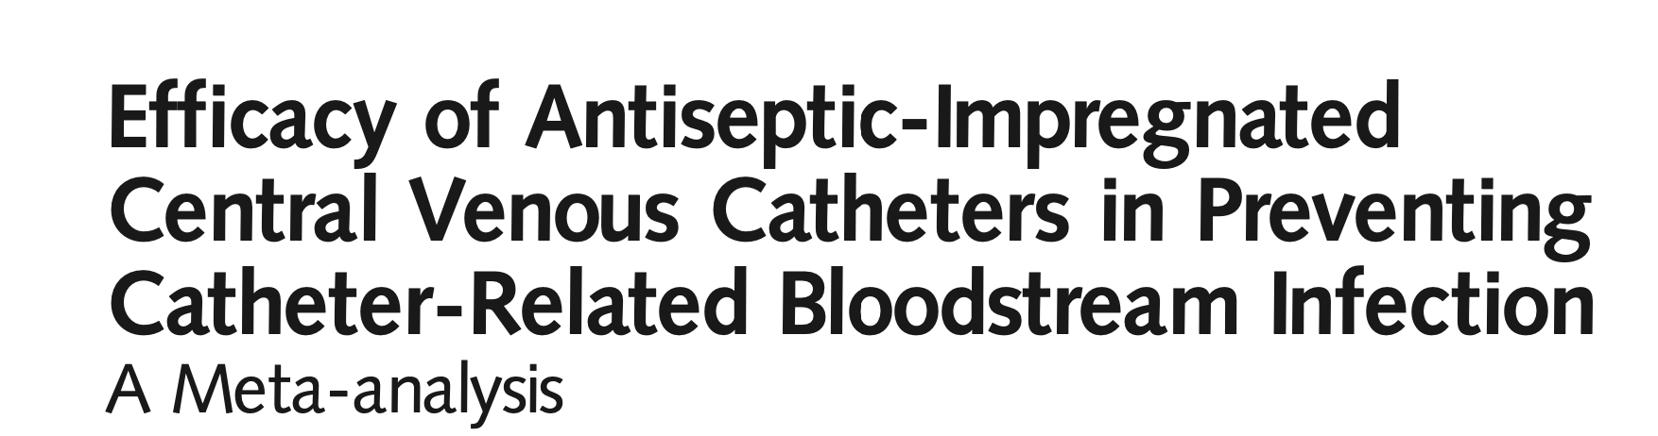
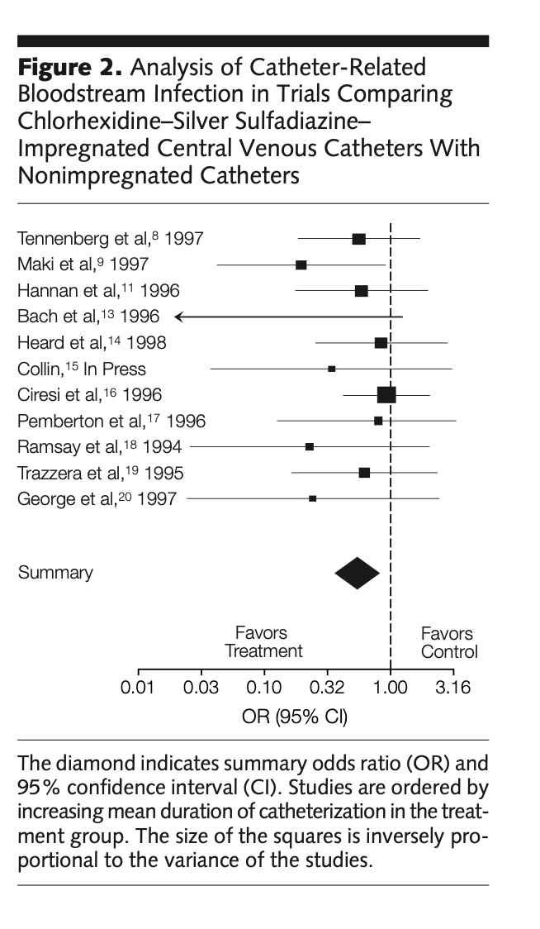
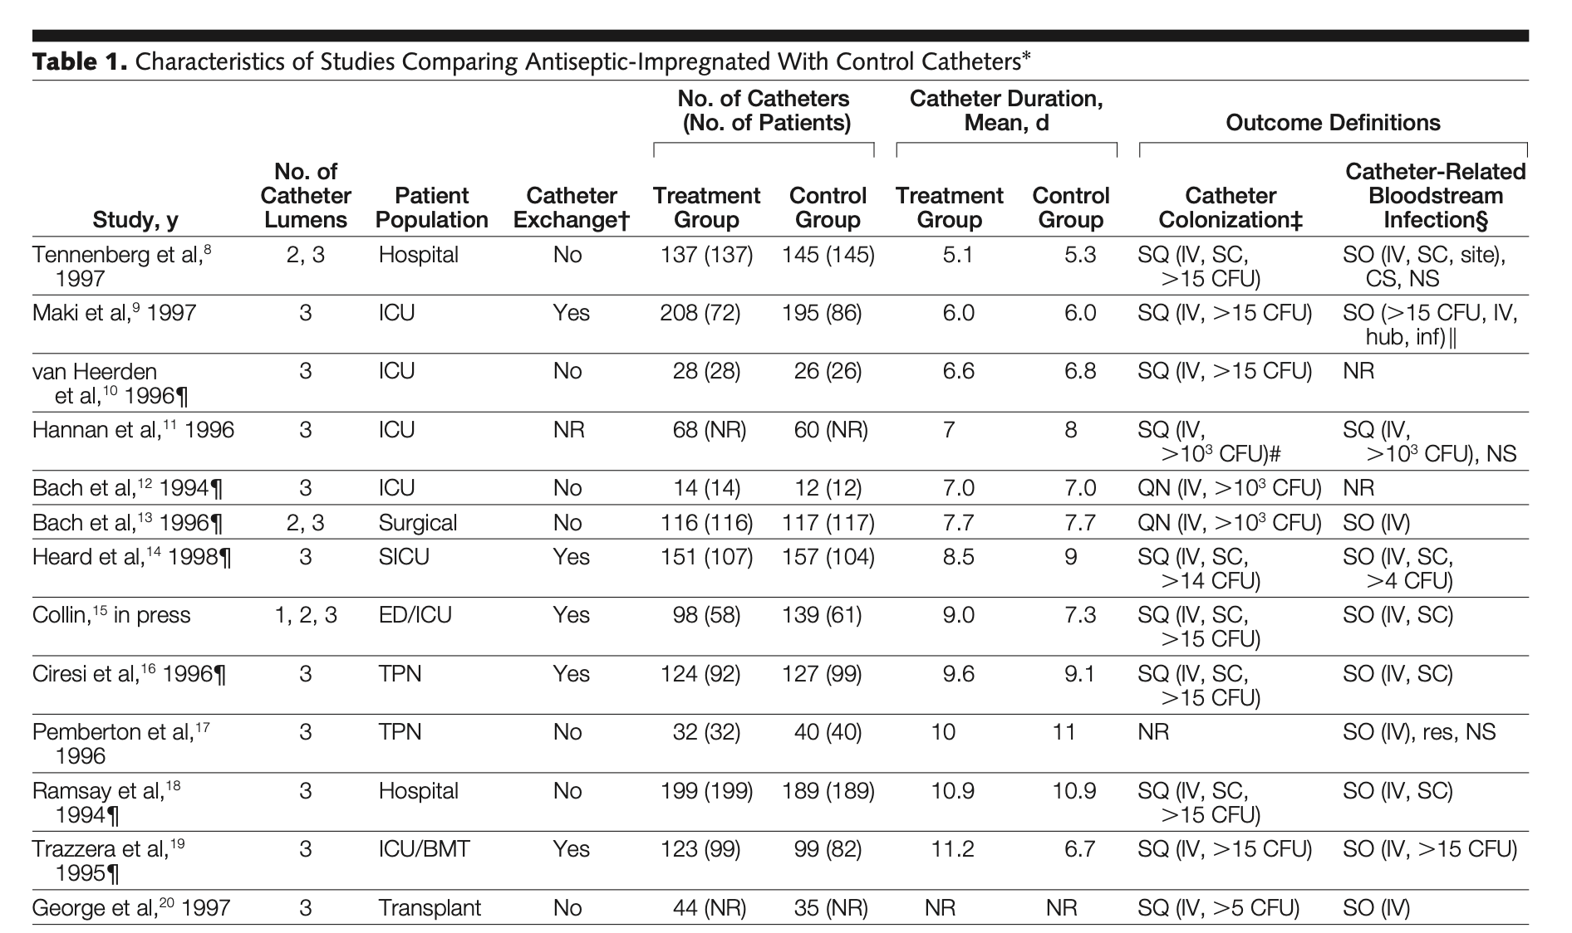
The findings of our meta-analysis indicate that central venous catheters impregnated with chlorhexidine-silver sulfadiazine are effective in reducing CR-BSI in high-risk patients requiring short-term catheterization and may provide a strategy for decreasing the overall incidence and cost of catheter-related infections. The decision to use these catheters should be made based on considerations of the baseline risk of CR-BSI in specific patient populations, potential reductions in morbidity and mor-tality, economic costs, and the risk of adverse events.
Meet the Experts

Slide 13
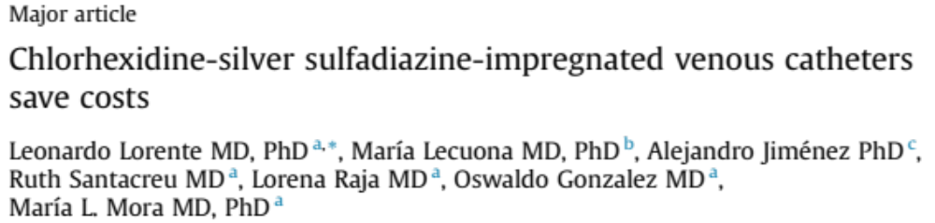

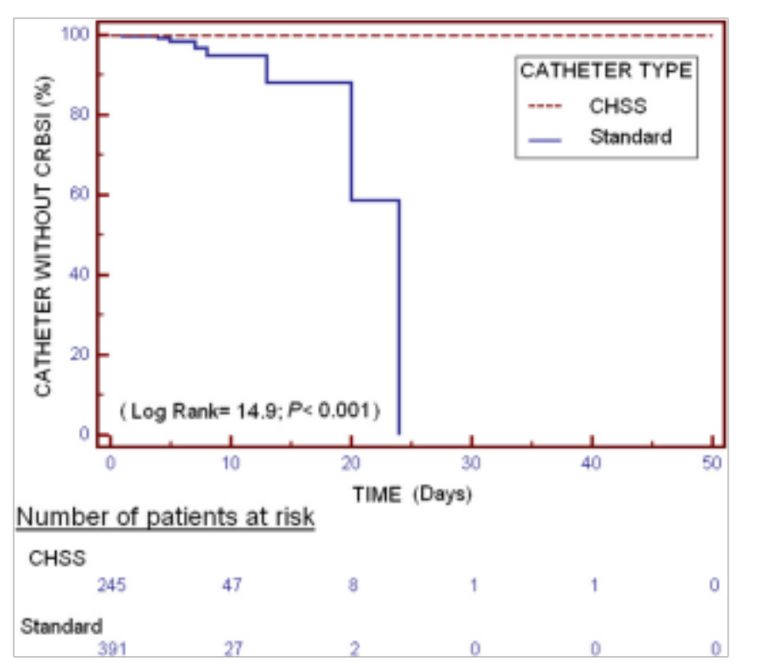
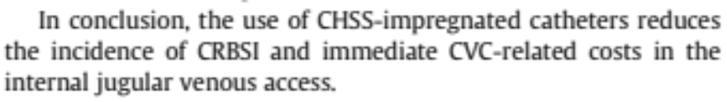
Meet the Experts

Slide 14
JUGULAR VEIN
Meet the Experts

Slide 15
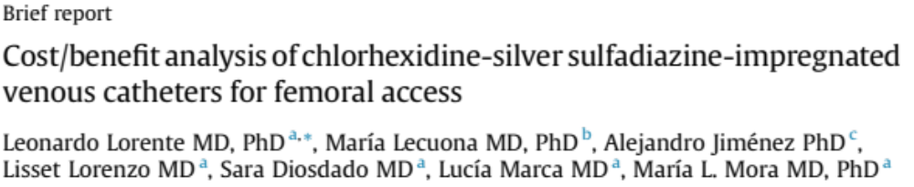
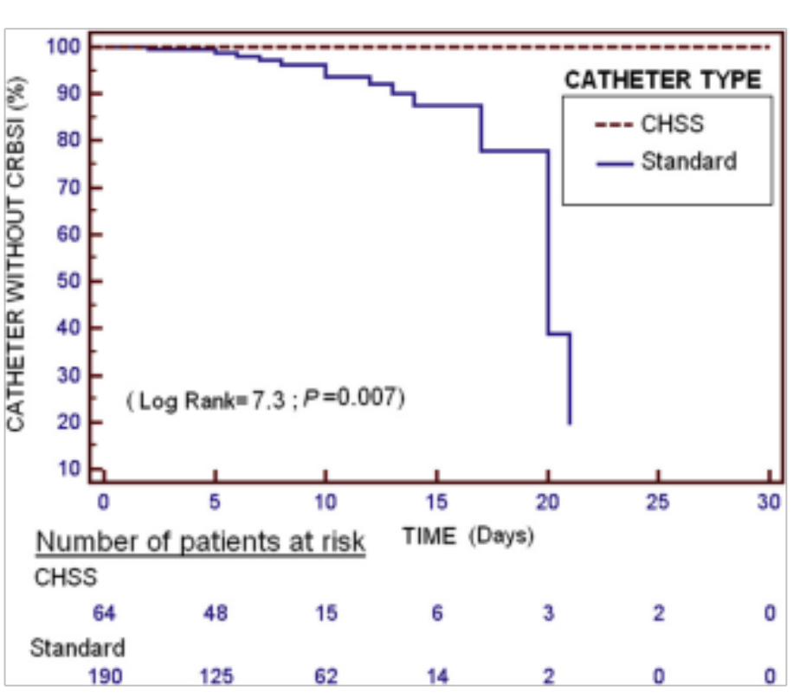

Meet the Experts

Slide 16
FEMORAL VEIN
Meet the Experts

Slide 17

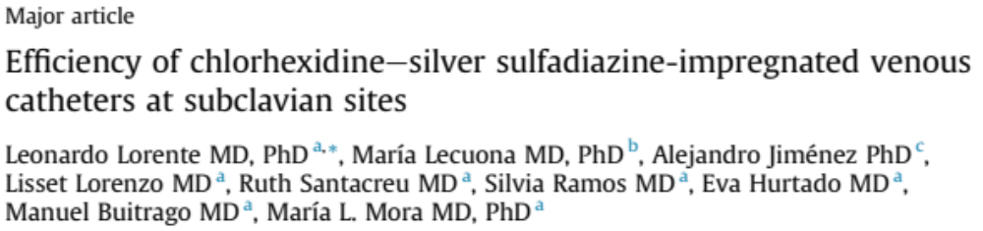
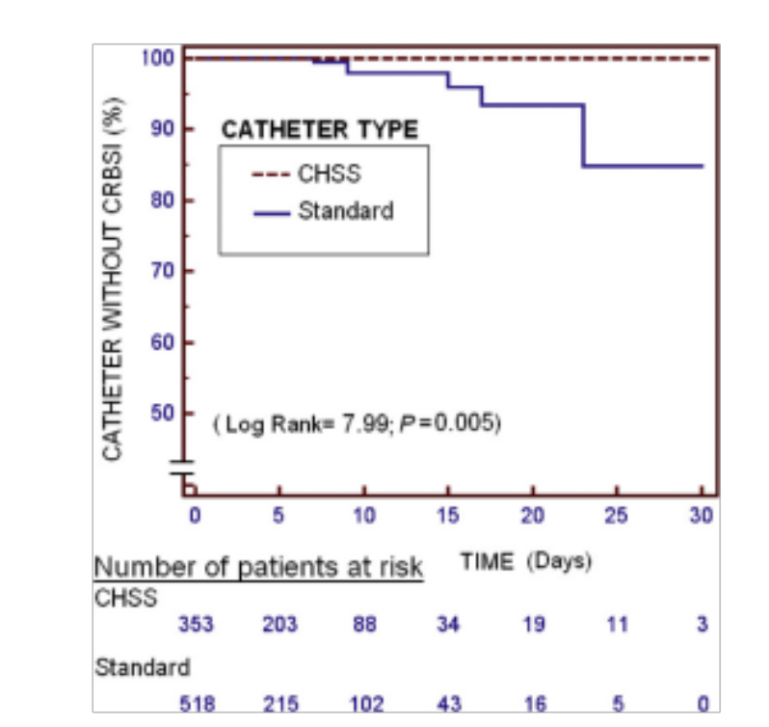
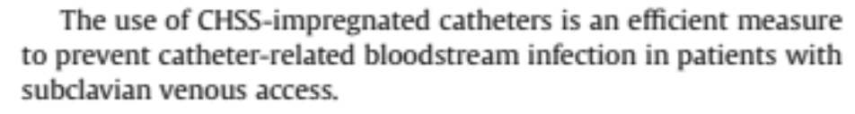
Meet the Experts

Slide 18
SUBCLAVIAN VEIN
Meet the Experts

Slide 19
LORENTE PAPERS ANALISYS
SITE | STANDARD CVC | CHG CVC | TOTAL | ADVANTAGE
FEMORAL | 8.61 | 0 | 254 | <.001
SUBCLAVIAN | 2.12 | 0 | 871 | 0.02
JUGULAR | 5.04 | 0 | 636 | <.001
Am J Infect Control. 2014 Mar;42(3):321-4
Am J Infect Control. 2014 Mar;42(3):1130-2.S16
Am J Infect Control. 2015 Mar;43(1):711-4
Meet the Experts

Slide 20

Do antimicrobial and antithrombogenic peripherally inserted central catheter (PICC) materials prevent catheter complications? An analysis of 42,562 hospitalized medical patients
Of 42,562 patients with a PICC, 39,806 (93.5%) were plain polyurethane, 2,263 (5.3%) incorporated antimicrobial materials, and 921 (2.2%) incorporated antithrombogenic materials.
Adjusting for known risk factors, antimicrobial PICCs were not associated with infection reduction (HR, 1.16; 95% CI, 0.82–1.64), and antithrombogenic PICCs were not associated with reduction in thrombosis and occlusion (HR, 1.15; 95% CI, 0.92–1.44). Results were consistent across populations and care settings.
Meet the Experts

Slide 21

Bridging the gap: introduction of an antimicrobial peripherally inserted central catheter (PICC) in response to high PICC central line-associated bloodstream infection incidence
Michelle DeVries, Thomas Sleweon
Published Online:1 Nov 2021 https://doi.org/10.12968/bjon.2021.30.19.S16
After 30 months of data collection, the PICC CLABSI incidence reduced from a baseline rate of 1.83/1000 PICC days to 0.162/1000 PICC days (91.15% reduction, P=0.0002).
Combined with continued compliance with basic prevention strategies (ie use of a central line insertion checklist/insertion bundle) and optimization of device selection and lumen justification, the introduction of an antimicrobial/ antithrombogenic (AM/AT) PICC was associated with a significant reduction in CLABSI.
Meet the Experts

Slide 22
Antimicrobial catheters
Useful in all contexts
Effectively reduce CVC-related infections in high-risk settings
Chlorhexidine-induced reduction of platelet adhesiveness appears to reduce thrombotic risk.
Warning on devices with antibiotic for risk of induction of resistance and allergic risk
Warning on silver products due to lack of efficacy over time
Chlorhexidine as the antiseptic of choice for the skin and thus for cvc coating
Efficacy on Mycetes only in Chlorhexidine Coating

Slide 23
Also…….

Slide 24
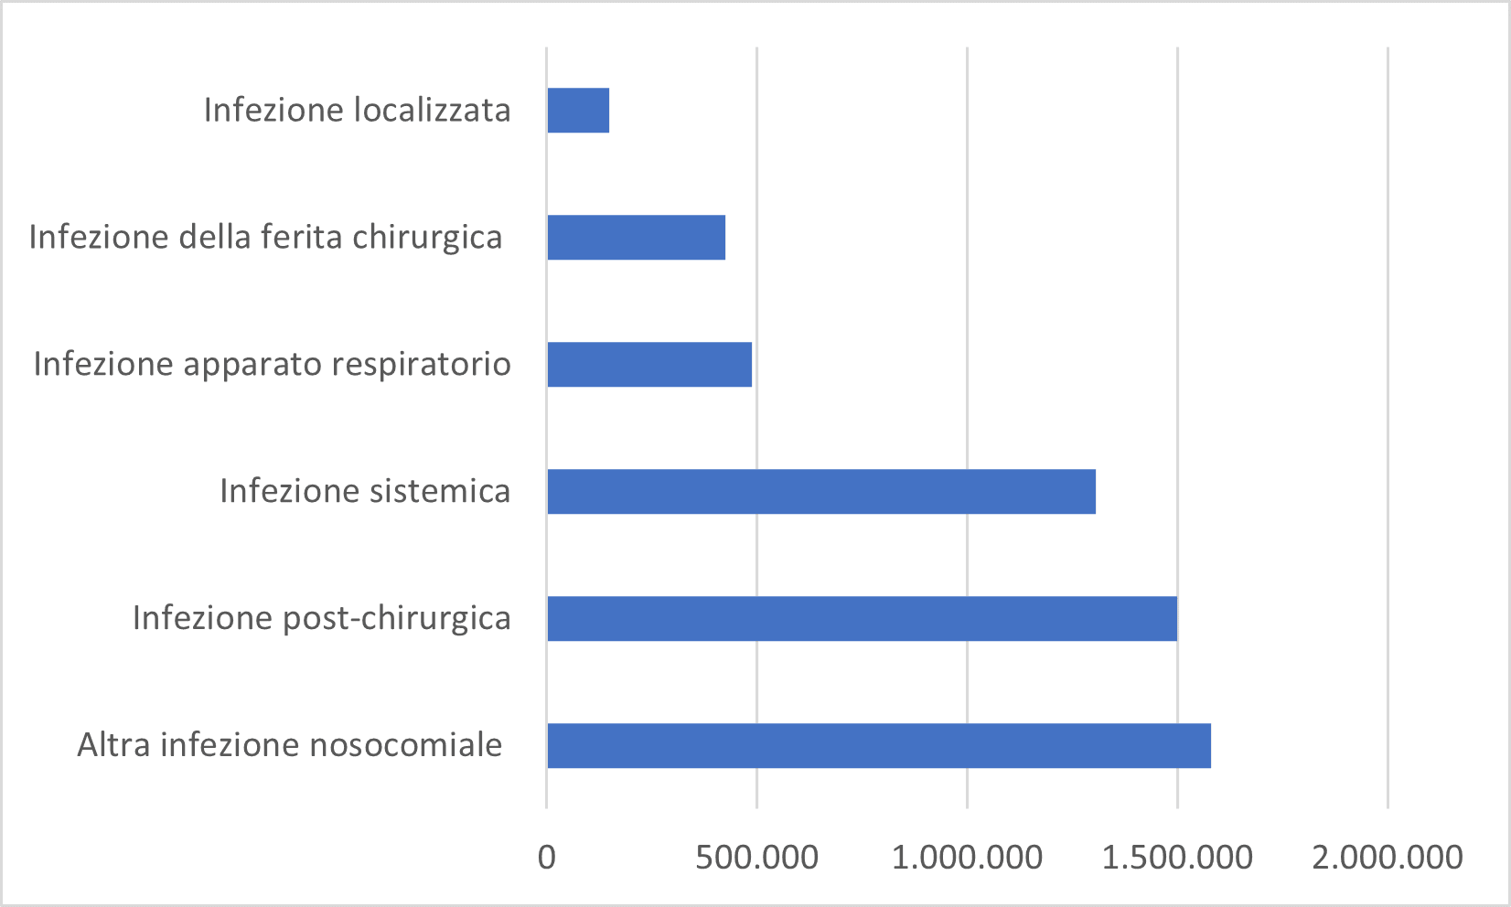
Medical Legal Implications
The average cost of compensation per ICA for a single case is more than 122,000 euro, with a settlement time of almost three years; the consequences for the patient, on the other hand, may result in prolonged hospitalisation, long-term disability or, in the worst case, death.They range from almost 150,000 euro in damages for a localised infection to 1.5 million euro for a post-surgical infection.
Infezioni correlate all'assistenza: cosa sono e cosa fare (salute.gov.it)
Meet the Experts

Slide 25

How to defend ourselves?
Court of Cassation 6386 of 3 March 2023"The case of nosocomial infections does not integrate a hypothesis of strict liability, the temporal criterion (i.e. the number of days elapsed after discharge from the hospital), the topographical criterion (i.e. the occurrence of the infection at the surgical site concerned by the operation) and the clinical criterion (whenever, by reason of the specificity of the infection, it is possible to verify what preventive measures were necessary to be taken) being relevant for the purposes of asserting the liability of the healthcare facility."
Court of Cassation 6386 of 3 March 2023
Meet the Experts

Slide 26
Implant Complications
Failure to cannulate the vein
Non progression of the catheter
Primary malposition
Pittiruti, M. (2022). Tip Navigation and Tip Location Methods. In: Biasucci, D.G., Disma, N.M., Pittiruti, M. (eds) Vascular Access in Neonates and Children. Springer, Cham. https://doi.org/10.1007/978-3-030-94709-5_6
Meet the Experts

Slide 27
Tip Navigation vs Tip Location
‘ Tip location' techniques make it possible to identify the correct position of the tip of the VAD if it has been run in the right directionl
‘Tip navigation' techniques allow the correct progression of the catheter whose correct tip position will be verified with an integrated 'tip location' technique
Pittiruti, M. (2022). Tip Navigation and Tip Location Methods. In: Biasucci, D.G., Disma, N.M., Pittiruti, M. (eds) Vascular Access in Neonates and Children. Springer, Cham. https://doi.org/10.1007/978-3-030-94709-5_6
Meet the Experts

Slide 28
Tip Navigation
Tip navigation techniques, under standard conditions, do not replace tip location techniques.Tip navigation techniques can reduce the risk of malpositioning in those particular categories of patients where tip location techniques cannot be used (e.g., ECG in patients with PM or AF).
7
Pittiruti, M. (2022). Tip Navigation and Tip Location Methods. In: Biasucci, D.G., Disma, N.M., Pittiruti, M. (eds) Vascular Access in Neonates and Children. Springer, Cham. https://doi.org/10.1007/978-3-030-94709-5_6
Meet the Experts

Slide 29
Pittiruti, M. (2022). Tip Navigation and Tip Location Methods. In: Biasucci, D.G., Disma, N.M., Pittiruti, M. (eds) Vascular Access in Neonates and Children. Springer, Cham. https://doi.org/10.1007/978-3-030-94709-5_6
Techniques for Tip Navigation
Imaging-based
Fluoroscopia, ecografia ed ecocardiografia
Tracking Elettromagnetico +/- IC-ECG
Sherlock 3CG (Bard), VPS Rhythm (Teleflex), Navigator (Corpak), CathRite (Micronix) …
Pressure based
Cat-Finder (Elcam)
ECG-based
Delta, Pilot (Vygon)
Doppler-based +/- IC-ECG
Vasonova (Teleflex)
Meet the Experts

Slide 30
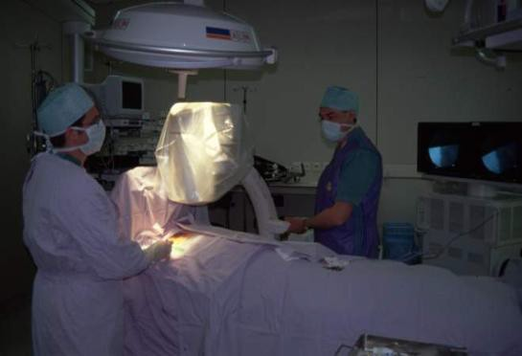
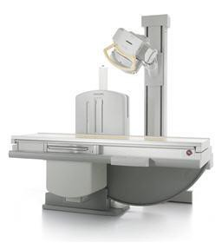
Pittiruti, M. (2022). Tip Navigation and Tip Location Methods. In: Biasucci, D.G., Disma, N.M., Pittiruti, M. (eds) Vascular Access in Neonates and Children. Springer, Cham. https://doi.org/10.1007/978-3-030-94709-5_6
LIMIT OF FLUOROSCOPY
Simultaneamente ‘tip navigation’ e ‘tip location’
Costosa Difficoltà logistiche e organizzative
Limiti dei reperi radiologici
Meet the Experts

Slide 31
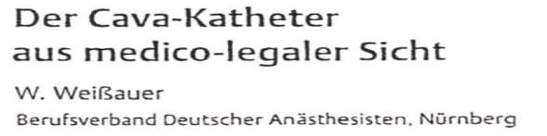
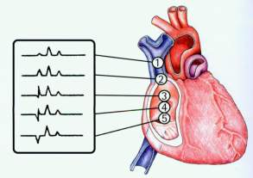
In Germany, the local anaesthesia society concluded as early as 1998 that it is permissible to use the ECG method instead of radiological monitoring (provided immediate complications can otherwise be ruled out):- established method and equally effective compared to radiology (both metal-guided technique and liquid column)- lower expenditure of resources- less exposure to ionising radiation
CVC Team Torino
Meet the Experts

Slide 32
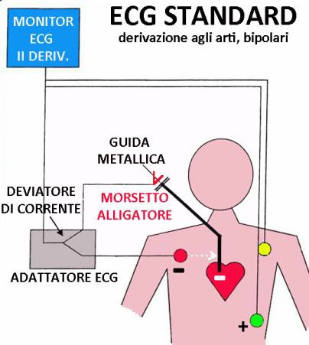

TECNICA DELL’ECG INTRACAVITARIO
CVC Team Torino
-
+
P basale
P max
P rise
Gebhard RE, The Accuracy of Electrocardiogram-Controlled Central Line Placement; Anesth Analg 2007; 104: 65-70
Meet the Experts

Slide 33
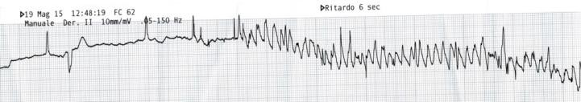
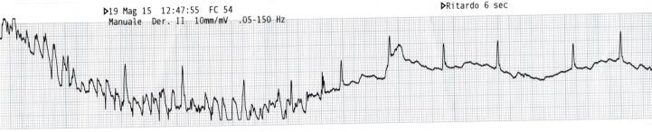
LIMITATIONS OF ELECTROCARDIOGRAPHIC TECHNIQUE
CVC Team Torino
fibrillazioni, flutter e tachicardia atriale parossistica
Schummer W. Modified ECG-guidance for optimal central venous catheter tip positioning. A transesophageal echocardiography controlled study Anaesthesist. 2005.
Meet the Experts

Slide 34
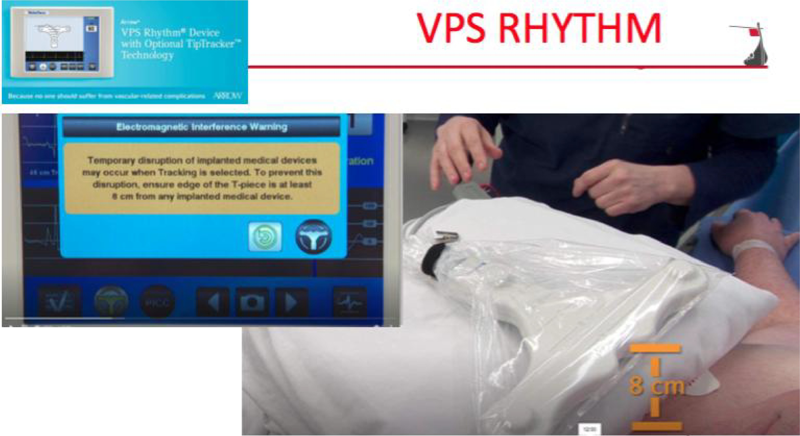
VPS Rythm
Meet the Experts

Slide 35
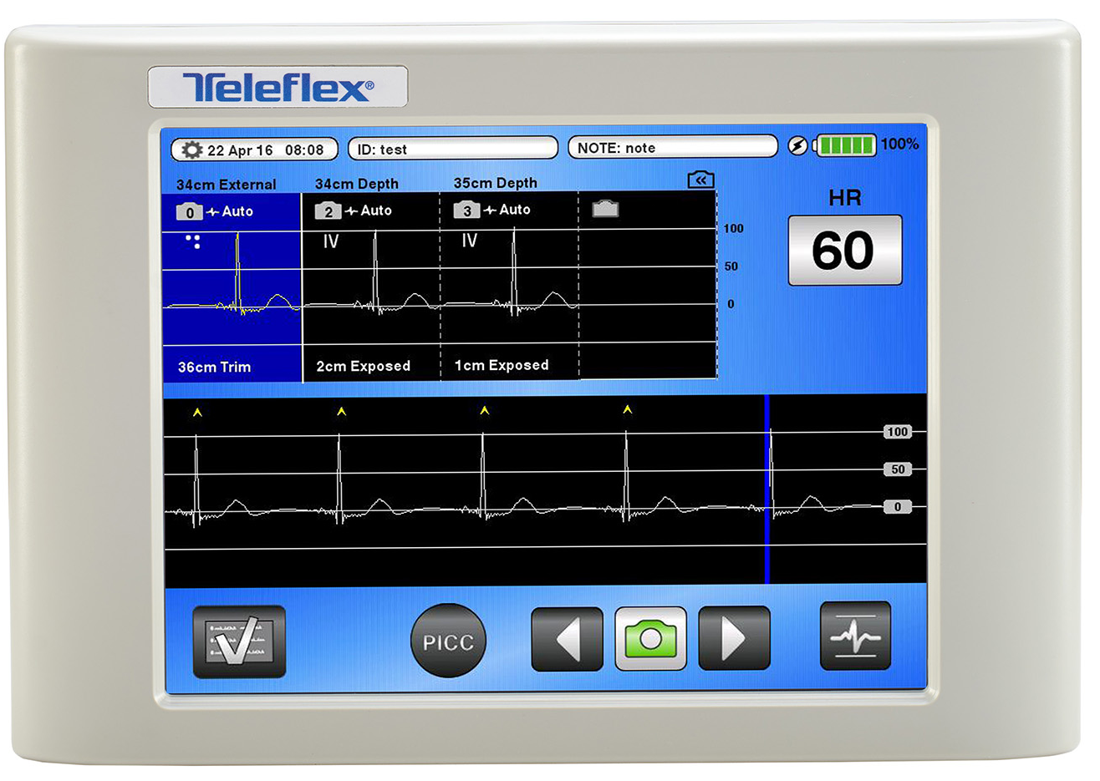
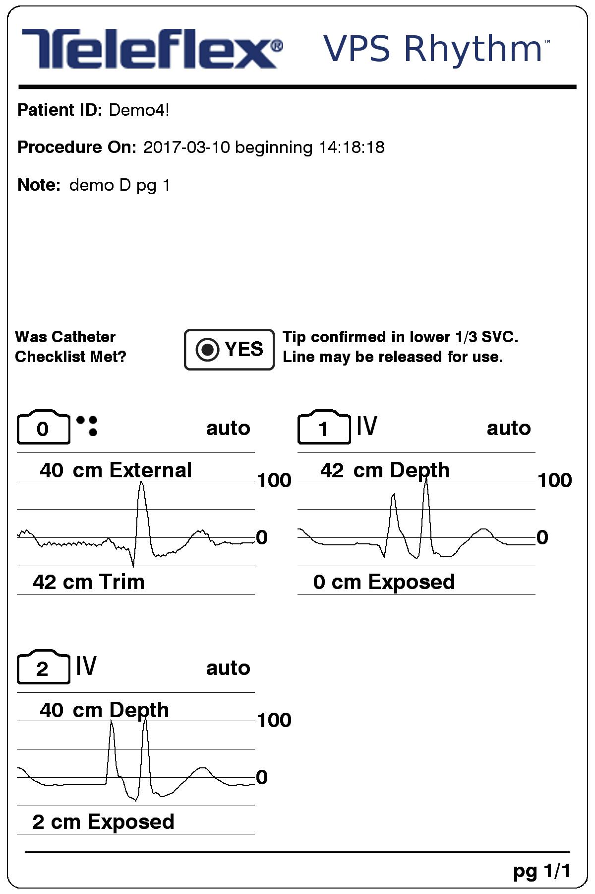
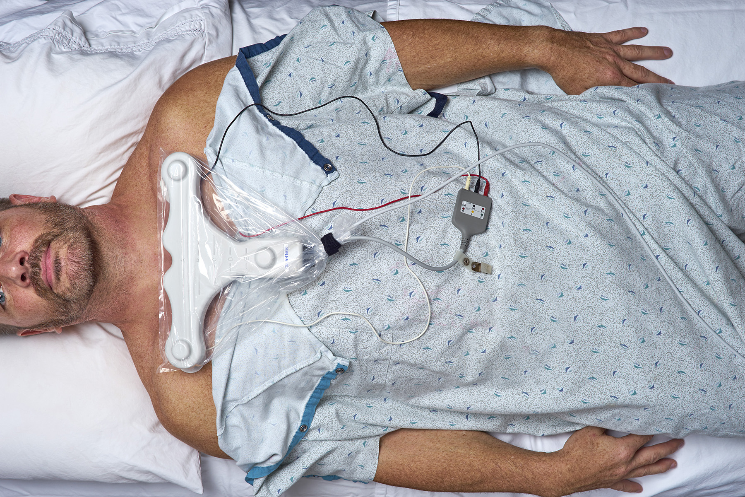
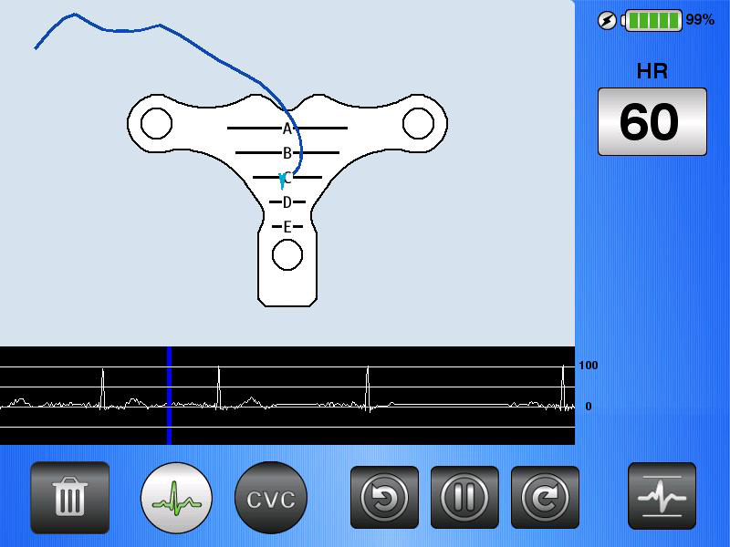
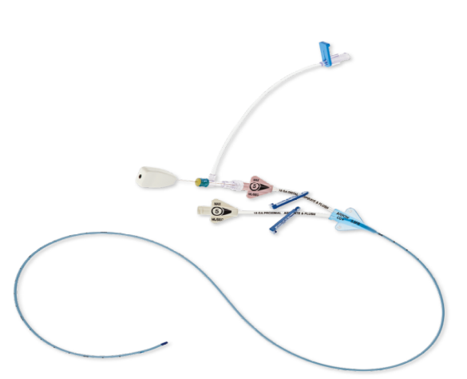
VPS Rythm: Current Version
Meet the Experts

Slide 36
Cost Effectiveness of ‘Tip Navigation’
As with any technique, achieving maximum cost-effectiveness from tip navigation requires:
A rational choice of material, methods, human resources and environment
Adequate assessment and planning
Entrusting the manoeuvre to trained personnel
An appropriate logistical organisation
Meet the Experts

Slide 37
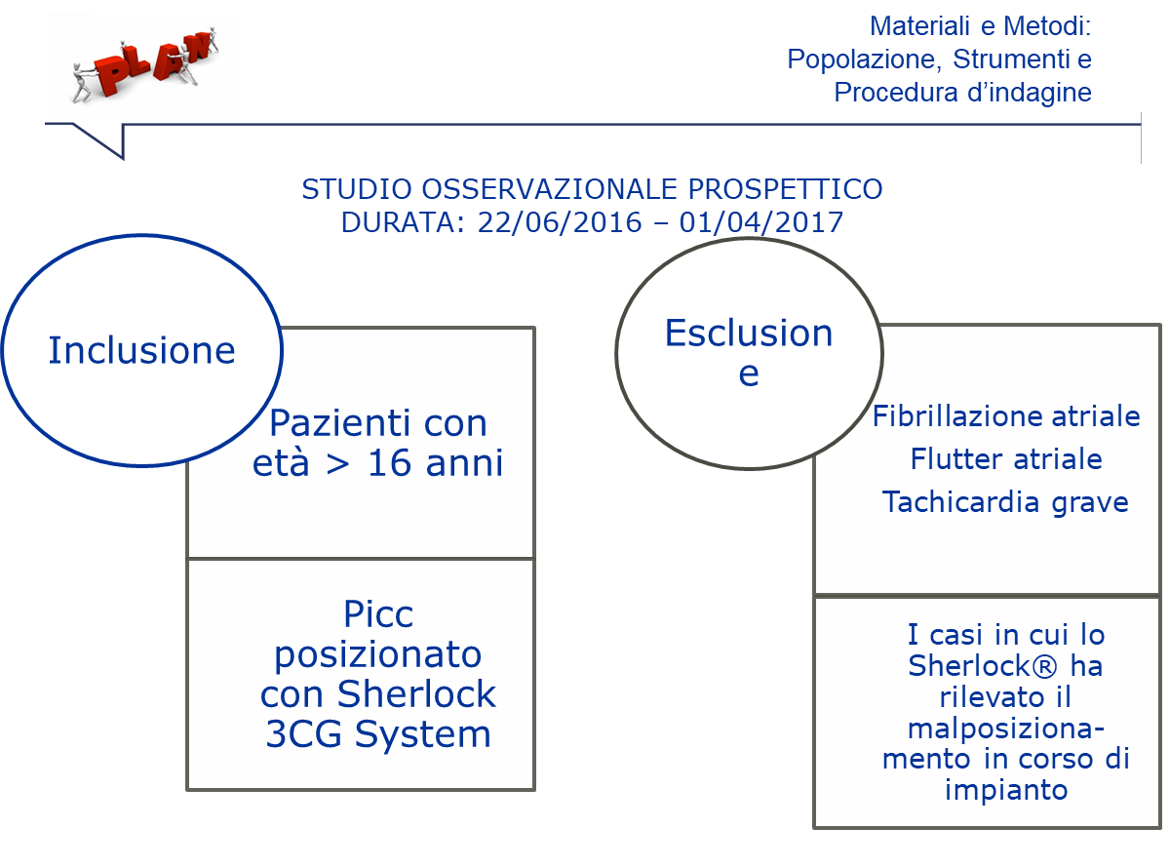
CVC Team Torino
Casi con fallimento del Tip Navigation + Ecg
Tip Navigation + Ecg
Meet the Experts
Notes:
Abbiamo condotto uno studio osservazionale prospettico monocentrico analizzando i dati raccolti dall’ambulatorio per l’impianto dei PICC presso il presidio Molinette di Torino, lo studio e la rilevazione dei dati è iniziata a giugno 2016 ed è terminata il 1 aprile 2017… e sono stati inclusi nello studio tutti i pazienti con età superiore ai 16 anni… leggi slide.

Slide 38

CVC Team Torino
Materials and Methods. Population, Instruments and Survey Procedure
Misurazione Antropometrica
Impianto con sistema Tip Navigation Ecg
Rx Torace di controllo
Date of placement | Sex of patient | Date of birth | Antrhropometric measurement | length of the positioned PICC | Report Rx post-implantation: position of the tip
Meet the Experts
Notes:
La procedura d’indagine prevedeva per ogni Picc impiantato l’esecuzione: leggi freccia
Per raccogliere i dati è stata costruita una tabella in exell articolta in due parti: la prima parte per raccogliere dati anagrafici del campione e la seconda parte relativa al posizionamento del PICC in cui si definisce la zona di impianto, la misurazione antropometrica, la lunghezza effettiva del catetere posizionato e il referto della radiografia di controllo.

Slide 39

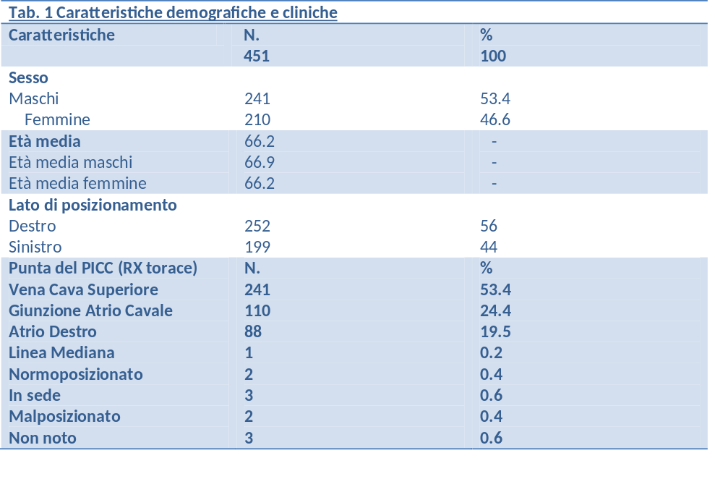
CVC Team Torino
Results:
Clinical and Demographic Characteristics
Meet the Experts
Notes:
il campione raccolto è stato di 451 pazienti le cui caratteristiche demografiche sono raccolte nella seguente tabella…leggi

Slide 40
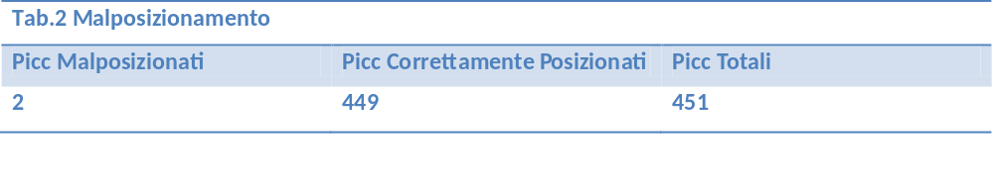
Result:
Malpositioning
Meet the Experts
Notes:
i mal posizionamenti rilevati sono stati 2 di cui: uno non confermato dalla lastra successiva eseguita due giorni dopo, mentre il secondo mal posizionamento fa riferimento a un picc impiantato su una donna obesa. In entrambi i casi il PICC è stato impiantato dal lato di destra. Nel primo caso il PICC è stato rilevatori 38 cm e vi è corrispondenza con la misurazione rilevata dallo sherlok, per il secondo mal posizionamento la misurazione antropometrica si è rilevata inferiore di 2 cm , rispetto a quella rilevata dallo strumento.

Slide 41


Discussion:
Malpositioning
IL TASSO DI MALPOSIZIONAMENTO RISCONTRATO E’ INFERIORE AI DATI PRESENTI IN LETTERATURA UTILIZZANDO TIP NAVIGATION + ECG
UN CASO DI MALPOSIZIONAMENTO E’ STATO SMENTITO DAL SECONDO CONTROLLO RADIOGRAFICO
L’UNICO CASO DI EFFETTIVO MALPOSIZIONAMENTO E’ STATO PROBABILMENTE FAVORITO DALLA PRESENZA DI OBESITA’
Meet the Experts
Notes:
quindi dopo un’attenta analisi e una valutazione dei dati possiamo affermare che il tasso di posizionamento riscontrato è inferiore ai dati presenti in letteratura utilizzando lo Sherlock, anche perché i due mal posizionamenti si sono verificati su due pazienti: dove in un caso ad un successivo controllo l’rx confermava una posizione della punta corretta e il secondo caso è legato alle caratteristiche fisiche della paziente. Nei pazienti obesi si può avere abbassamento del diaframma e del mediastino nel passaggio da posizione supina ad ortostatica, con conseguente dislocazione della punta.

Slide 42
TIP LOCATION ED ECG: DA OPPORTUNITA’ AD OBBLIGO

Slide 43

Law 101/2020
The first articles of Legislative Decree 101/2020 state, as before, that the principles
on which radiation protection is based are: justification, optimisation and
dose limitation, with some noveltiese
the justification process must take into account "the results of
scientific research and recognised guidelines within the framework of the National System referred to in the
law no. 24 of 8 March 2017"
Exposure to radiation for diagnostic purposes should be avoided if an alternative of equal or greater effectiveness is available
Meet the Experts
Supplemento ordinario alla “Gazzetta Ufficiale„ n. 201 del 12 agosto 2020 - Serie generale

Slide 44
References
Slides 3-4 JPEN J Parenter Enteral Nutr. 2017 Sep;41(7):1178-1187.doi: 10.1177/0148607116655449. Epub 2016 Jun 20
Slides 5-12 Global guidelines for the prevention of surgical site infection, 2nd ed. ISBN: 9789241550475
Slides 14-15 O’Grady NP, Alexander M, Burns LA, Patchen Dellinger E, Garland J, Heard SO, et al. Guidelines for the prevention of intravascular catheter-related infections. 2011. Centers for disease control and Prevention; 2011. Available from: DIALOG
Slides 16 Ann Ig 2020; 32(4): 357-367 doi:10.7416/ai.2020.2359
Slides 13- J Infus Nurs. 2011 Sep-Oct;34(5):309-13. doi: 10.1097/NAN.0b013e3182285e43.
Slides 17 https://www.cdc.gov/nhsn/pdfs/pscmanual/4psc_clabscurrent.pdf
Slides 18 Annals of Surgery 274(6):p e481-e488, December 2021. | DOI: 10.1097/SLA.0000000000004076
Slides 19-20 https://apic.org/
Slide 22 www.gavecelt.infoCatheter-Associated Bloodstream
Slides 25-27 Infections in the NICU: Getting to Zero Sabra Curry, NNP-BC, MSN, APN Michele Honeycutt, RN, BSN, CIC Gail Goins, RNC Craig Gilliam, BSMT, CI NEONATAL NETWORK VOL. 28, NO. 3, may / june 2009
Slide 28 JAMA. 1999 Jan 20;281(3):261-7. doi: 10.1001/jama.281.3.261.
Slide 29 Chest. 2003 Jul;124(1):275-84.
Slides 30-31 Anesth Analg. 2005 Dec;101(6):1778-1784.
Slides 32-33 Surg Infect (Larchmt) . 2007 Aug;8(4):445-54. doi: 10.1089/sur.2006.073.
Slide 34 Lancet Infect Dis . 2008 Dec;8(12):763-76. doi: 10.1016/S1473-3099(08)70280-9.
Slides 35-36 Journal of Hospital Infection Volume 72, Issue 3, July 2009, Pages 227-233
Slides 37-38 Eur J Cancer Care (Engl). 2009 Sep;18(5):477-82.
Slides 39-41 J Hosp Infect. 2010 Sep;76(1):1-11. doi: 10.1016/j.jhin.2010.04.025.

Slide 45
References
Slides 42-43 Am J Infect Control. 2014 Mar;42(3):321-4
Slides 44-45 Am J Infect Control. 2014 Mar;42(3):1130-2.S16
Slides 46-47 Am J Infect Control. 2015 Mar;43(1):711-4
Slides 49-50 Clinical Infectious Diseases, Volume 64, Issue suppl_2, 15 May 2017, Pages S131–S140, https://doi.org/10.1093/cid/cix019
Slide 51 Published Online:1 Nov 2021 https://doi.org/10.12968/bjon.2021.30.19
Slide 52 https://doi.org/10.12968/bjon.2021.30.19.S16
Slides 54-55 Journal of International Medical Research 2017, Vol. 45(3) 1042–1053
Slide 56 NEW MICROBIOLOGICA, 35, 175-182, 2012
Slides 57-58 Antimicrob Resist Infect Control 1, 40 (2012). https://doi.org/10.1186/2047-2994-1-40
Slide 59 Surgical Infection Vol.8 N.4 2007 DOI:10.1089/sur.2006.073
Slides 62-64 Clinical Infectious Diseases. 52(2), p211-212
Slides 65-66 Critical Care Nursing Quarterly/January-March 2011
Slides 68-72 Infect Control Hosp Epidemiol 2022 Apr;43(4):427-434. doi: 10.1017/ice.2021.141. Epub 2021 Apr 28.
Slide 73 Infezioni correlate all'assistenza: cosa sono e cosa fare (salute.gov.it)
Slide 74 Court of Cassation 6386 of 3 March 2023

Slide 46
References
Slides 3-7 Pittiruti, M. (2022). Tip Navigation and Tip Location Methods. In: Biasucci, D.G., Disma, N.M., Pittiruti, M. (eds) Vascular Access in Neonates and Children. Springer, Cham. https://doi.org/10.1007/978-3-030-94709-5_6Journal of the Association for Vascular Access (2007) 12 (3): 138–139.https://doi.org/10.2309/java.12-3-8
Slide 8 Anästhesiol Intensivmed Notfallmed Schmerzther 1998; 33(2): 117-118 DOI: 10.1055/s-2007-994223
Slide 9 Anestesiol. Intensivemed. Notfallmed. Schmerzther 1998 33 117
Slide 10 Anesth Analg. 2007 Jan;104(1):65-70. doi: 10.1213/01.ane.0000250224.02440.fe.
Slide 11 Anaesthesist. 2005 Oct;54(10):983-90. doi: 10.1007/s00101-005-0886-2.
Slides 15 e 17-18 Youtube Teleflex Account
Slides 21-25 https://journals.sagepub.com/doi/full/10.1177/1129729818778929
Slide 28 Supplemento ordinario alla “Gazzetta Ufficiale„ n. 201 del 12 agosto 2020 - Serie generale

Slide 47
MCI-2023-0581
Questions?
Any Questions?
Teleflex, the Teleflex logo are trademarks or registered trademarks of Teleflex Incorporated or its affiliates, in the U.S. and/or other countries.
© 2023 Teleflex Incorporated. All rights reserved. MCI-2023-0581

Slide 48
MCI-2023-0581
Thank You
Thank You
Teleflex, the Teleflex logo are trademarks or registered trademarks of Teleflex Incorporated or its affiliates, in the U.S. and/or other countries.
© 2023 Teleflex Incorporated. All rights reserved. MCI-2023-0581

