Slide 1

Rianimazione e Terapia Intensiva: il ruolo dell’accesso vascolare nella riduzione delle infezioni catetere correlate
Fulvio Pinelli
Azienda Ospedaliero Universitaria Careggi
Firenze

Slide 2

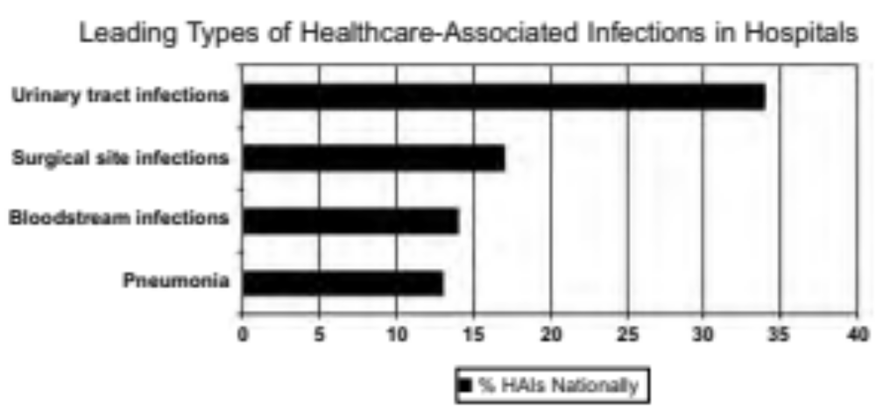
http://www.hhs.gov/ash/initiatives/hai/introduction.html

Slide 3
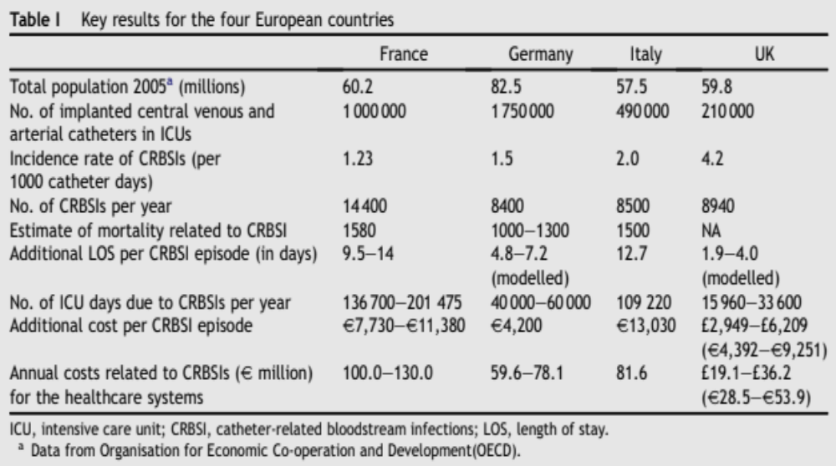
CRBSI: DIMENSION OF THE PROBLEM
Tacconelli J Hosp Inf 2009

Slide 4
DIAGNOSIS
LOCAL INFECTIONS
Exit Site
Tunnel
Pocket
SISTEMIC INFECTIONS (CRBSI)

Slide 5

DIAGNOSIS
Sistemic Infections (CRBSI)
BSI in a patient with a vascular access, clinical signs of infections (fever, shivers, and or hypotension), without any other apparent source of infection and at least on of the following:
Quantitative or semiquantitative colture of a catheter with isolation of the same germ (same spp. and antibiogram) from blood and from the catheter;
Quantitative blood colture from catheter and peripheral vein with a growth ratio > 3-5:1 (catheter vs peripheral blood);
Positivization of peripheral blood colture in 2 or more hrs than blood coltures from catheters (Differential Time to Positivity, DTP).

Slide 6
IS THERE A ROLE OF VASCULAR ACCESS
IN REDUCING CRBSI?
IS THERE A BENEFIT OF A VASCULAR ACCESS OVER ANOTHER IN TERMS OF INFECTION RISK?

Slide 7
WoCoVA TERMINOLOGY
PICC (Peripheral Inserted Central Catheters)
CICC (Centrally Inserted Central Catheters)
FICC (Femorally Inserted Central Catheters)

Slide 8
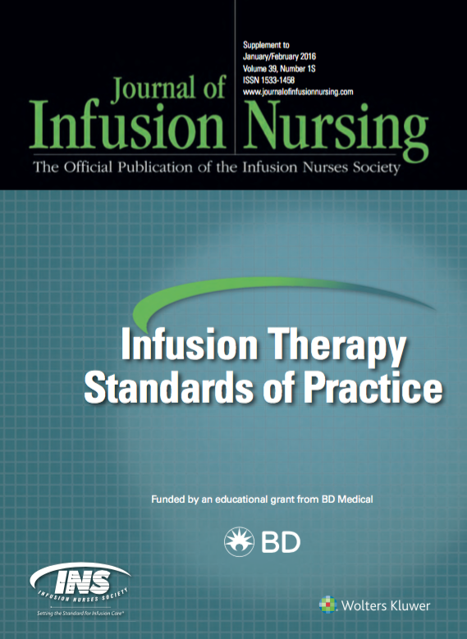

2016

Slide 9
RECOMMENDATION # 1
INSERT A VAD ONLY IF NECESSARY
e.g. : VAD requested for parenteral nutrition,
whereas an enteric feeding would be possible.

Slide 10
RECOMMENDATION # 2
IF A VAD IS REQUIRED PREFER A PERIPHERAL VAD
O.1 vs 2.7 %
Maki 2007

Slide 11
RECOMMENDATION # 3
IF A CVAD IS REQUIRED SELECT CAREFULLY THE EXIT SITE

Slide 12
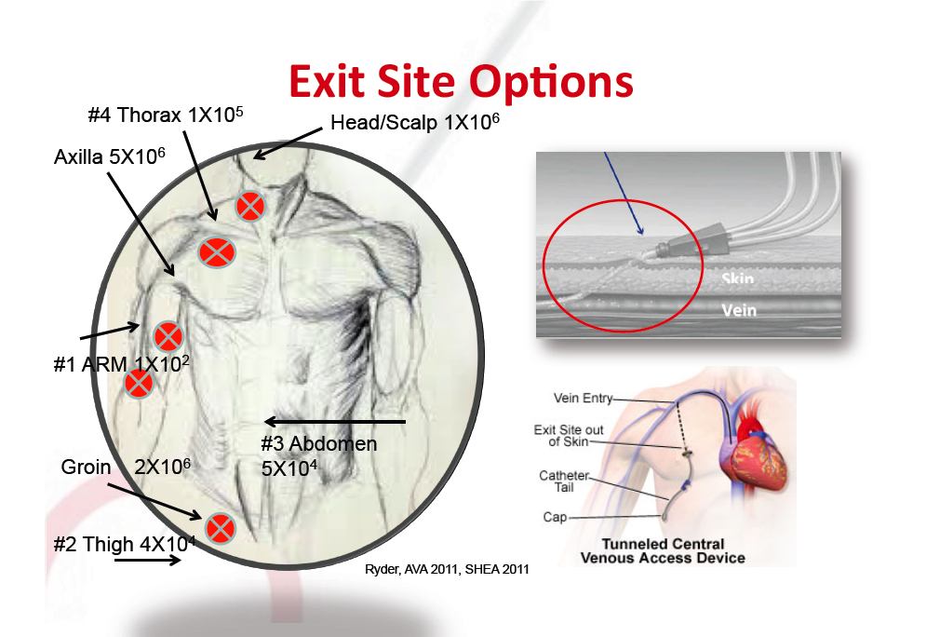
THE CRUCIAL POINT IS THE EXIT SITE

Slide 13
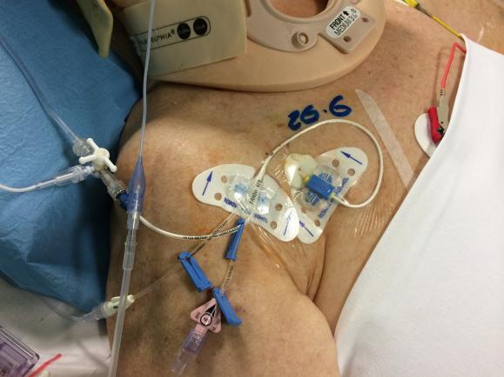
Infra-clavicular

Slide 14
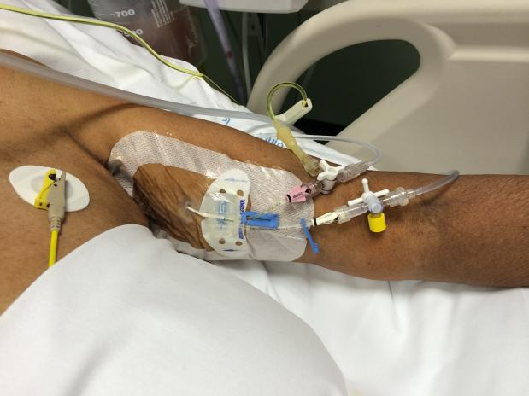
At upper arm

Slide 15
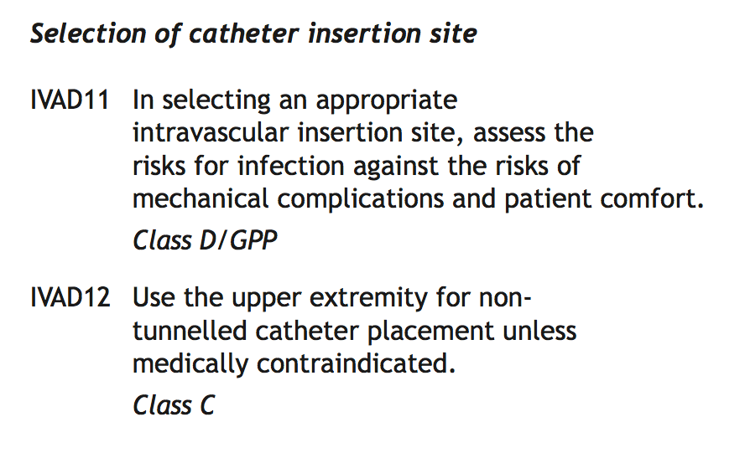

Slide 16
PICC = low risk of infection
Why ?
Exit site is distant from nasal/oral/tracheal secretions
Low contamination of arm skin
Physical characteristics of arm skin (dry, thin)
Exit site allows better cleaning and better stabilization of the dressing

Slide 17
PICC = low risk of infection
Studies on CRBSI with ultrasound-guided PICCs:
0.4/1000 days (Pittiruti 2006 – pts on PN)
0/1000 days (Harnage 2006)
0.3/1000 days (Scoppettuolo 2010 – infect.dis.pts)
0/1000 days (Cotogni 2013 – cancer pts on HPN)
0/1000 days (Botella 2013 – cancer pts on HPN)
0.3/1000 days (Zerla 2015 – hosp.pts)
0.01/1000 days (Zerla 2015 – home care)
0/1000 days (Nolan 2015 – ICU pts)
0/1000 days (Bolis 2017 – ICU pts)

Slide 18
N.B.
In some ICU patients, an emergency site at the upper arm is particularly indicated:
  Tracheostomy
  Wound/infection of neck and chest
  Orthopedic devices
  Helmets for NIV

Slide 19
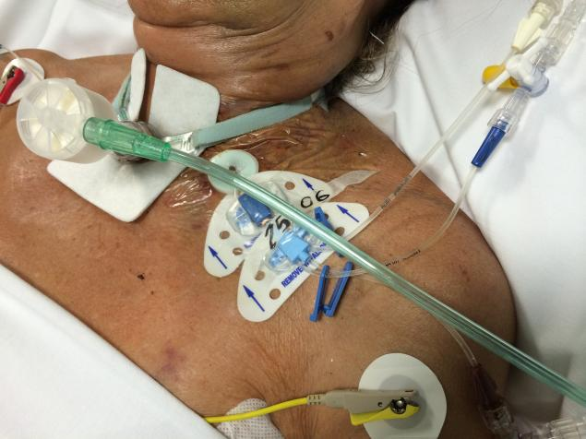
Wouldn’t a PICC have been a better choice?

Slide 20
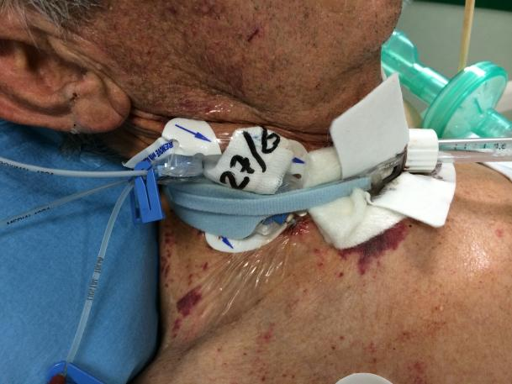
Wouldn’t a PICC have been a better choice?

Slide 21
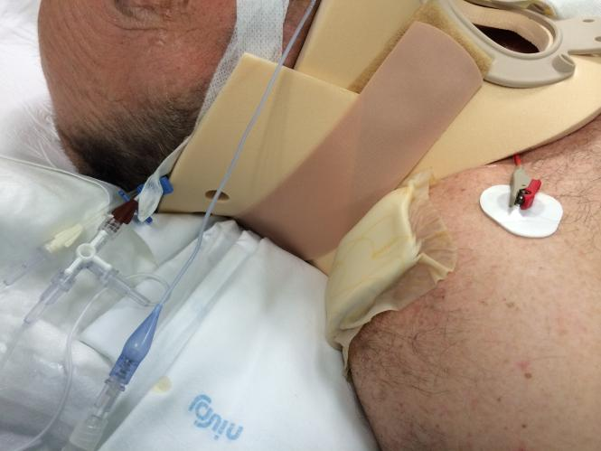
Wouldn’t a PICC have been a better choice?

Slide 22
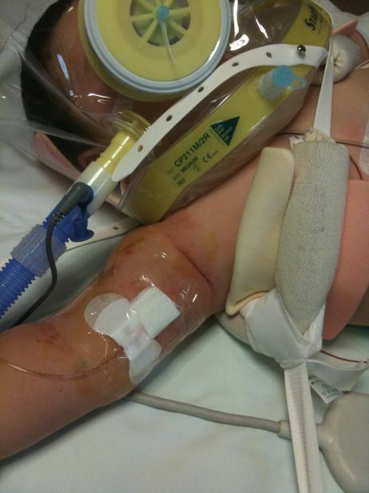
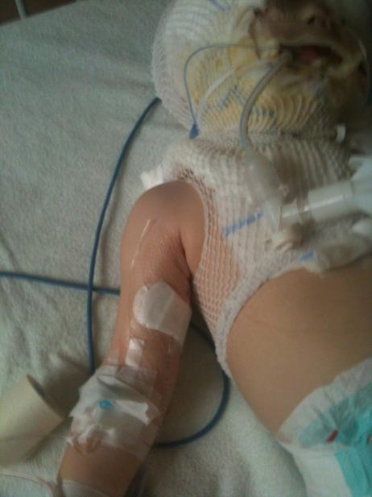
Wouldn’t a PICC have been a better choice?

Slide 23
CICC vs PICC
No RCT
RISK OF INFECTION
CICC = Higher risk than PICCs, in some patients:
  In patients with tracheostomy
  When emergency site is at mid-neck
  When the CICC has been inserted without a proper insertion protocol

Slide 24
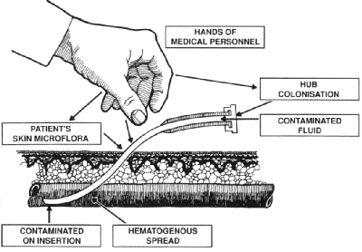
PATHOGENESIS
MANO DELL’OPERATORE
COLONZZAZIONE
ESTREMITA’
MICROFLORA CUTE DEL
PAZIENTE
FLUIDO CONTAMINATO
CONTAMINAZIONE
DA INSERZIONE
PROPAGAZIONE
EMATOGENA
24
Notes:
Pathogenesis
There are four recognized routes for contamination of catheters:
1. migration of skin organisms at the insertion site into the cutaneous catheter tract and along the surface of the catheter with colonization of the catheter tip; this is the most common route of infection for short-term catheters
direct contamination of the catheter or catheter hub by contact with hands or contaminated fluids or devices
less commonly, catheters might become hematogenously seeded from another focus of infection
rarely, infusate contamination might lead to CRBSI [216].

Slide 25
RECOMMENDATION # 4
USE AN INFECTION PREVENTION BUNDLE

Slide 26
BUNDLE DI PREVENZIONE DELLE INFEZIONI
Igiene delle mani, massime precauzioni di barriera durante l’impianto del catetere venoso
Scelta appropriata del sito di inserzione (metà braccio, zona sottoclaveare, zona sopraclaveare, collo, inguine)
Impianto ecoguidato, ovunque possibile, sia per i cateteri a inserzione centrale che per i cateteri a inserzione periferica
Utilizzo di clorexidina al 2% per la disinfezione cutanea prima dell’inserzione nonché per la disinfezione continua o discontinua dell’exit site
Impiego di “sutureless devices” per il fissaggio del catetere, ovunque possibile
Impiego di medicazioni semipermeabili trasparenti, ovunque possibile
Rimozione immediata del catetere venoso centrale non più indispensabile
Notes:
Non ci stancheremo mai di ricordare abbastanza

Slide 27
CONCLUSIONS
CRBSI ARE AN IMPORTANT ISSUE IN ICU IN TERMS OF MORBIDITY, MORTALITY AND COSTS;
NOT ENOUGH EVIDENCE TO PREFER PICC vs CICC IN ICU BASED ONLY ON INFECTIOUS RISK;
PICC IN SPECIFIC SITUATION MAY BE A SAFER ALTERNATIVE TO CICC;
MAXIMAL BENEFIT IF INSERTED USING A WELL DEFINED INFECTION PREVENTION BUNDLE.
Notes:
Large scale prospective clinical trials needed
– Comparing CICCs to PICCs in ICU
• Rates of CRBSIs
• Catheter dwell times
• Overall catheter performance
• Risks associated with catheter insertion
• Techniques for catheter insertion
• Protocols for catheter maintenance

Slide 28
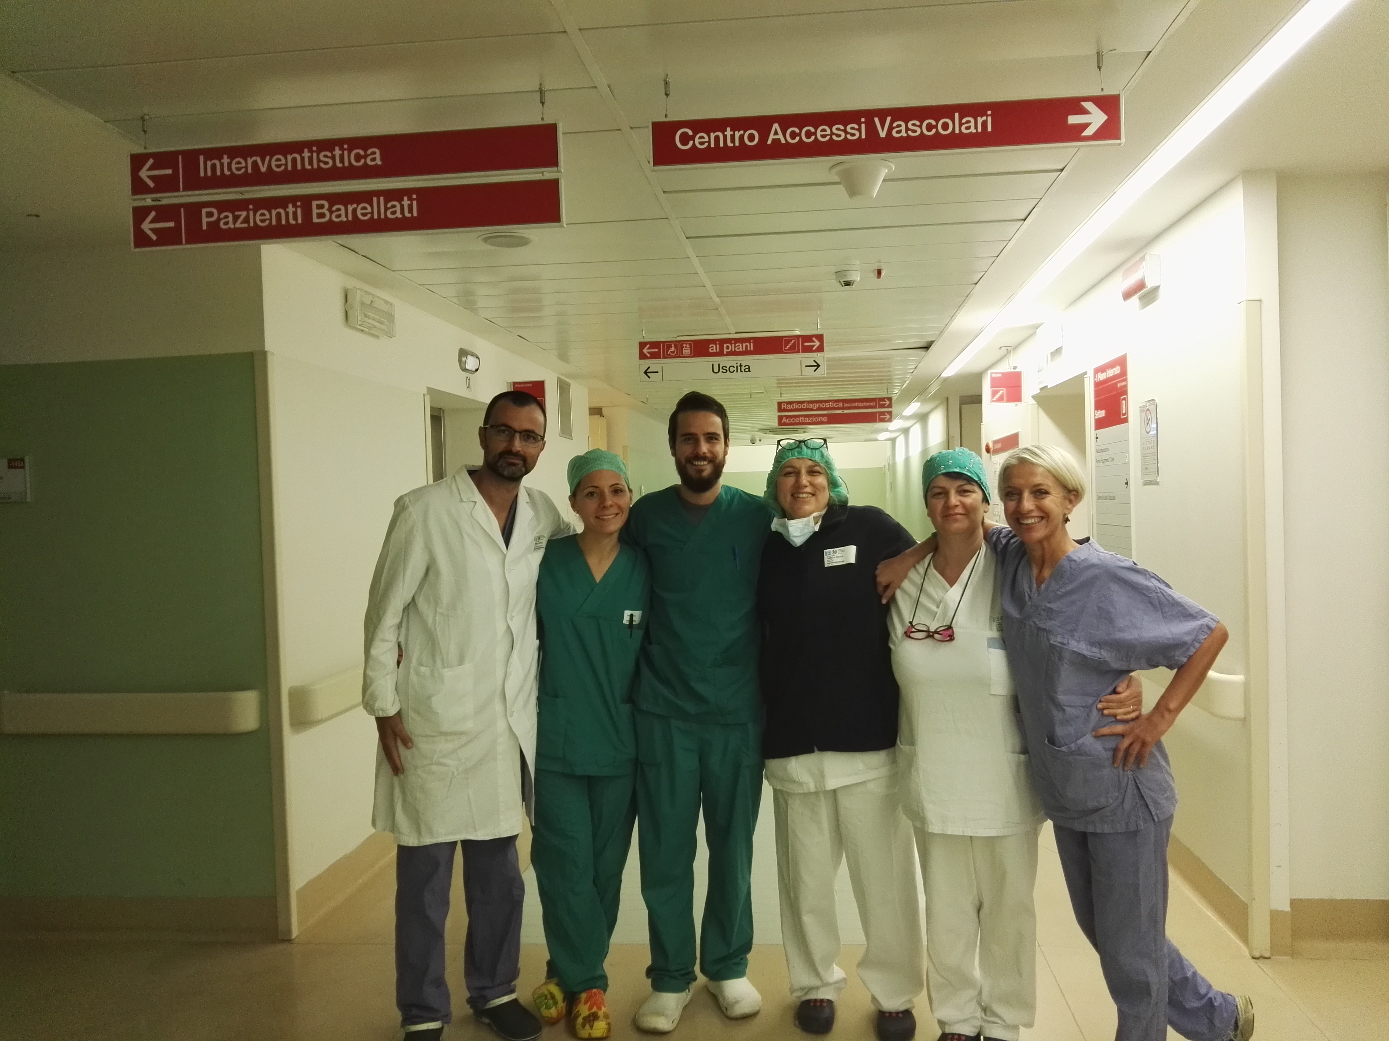


GRAZIE.
pinellif@gmail.com

